Slide 1

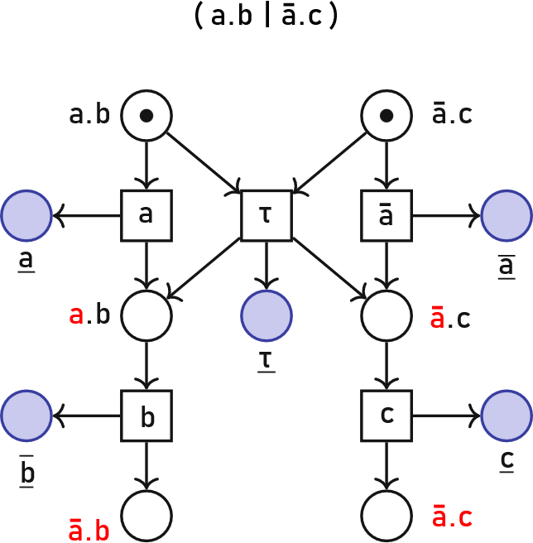
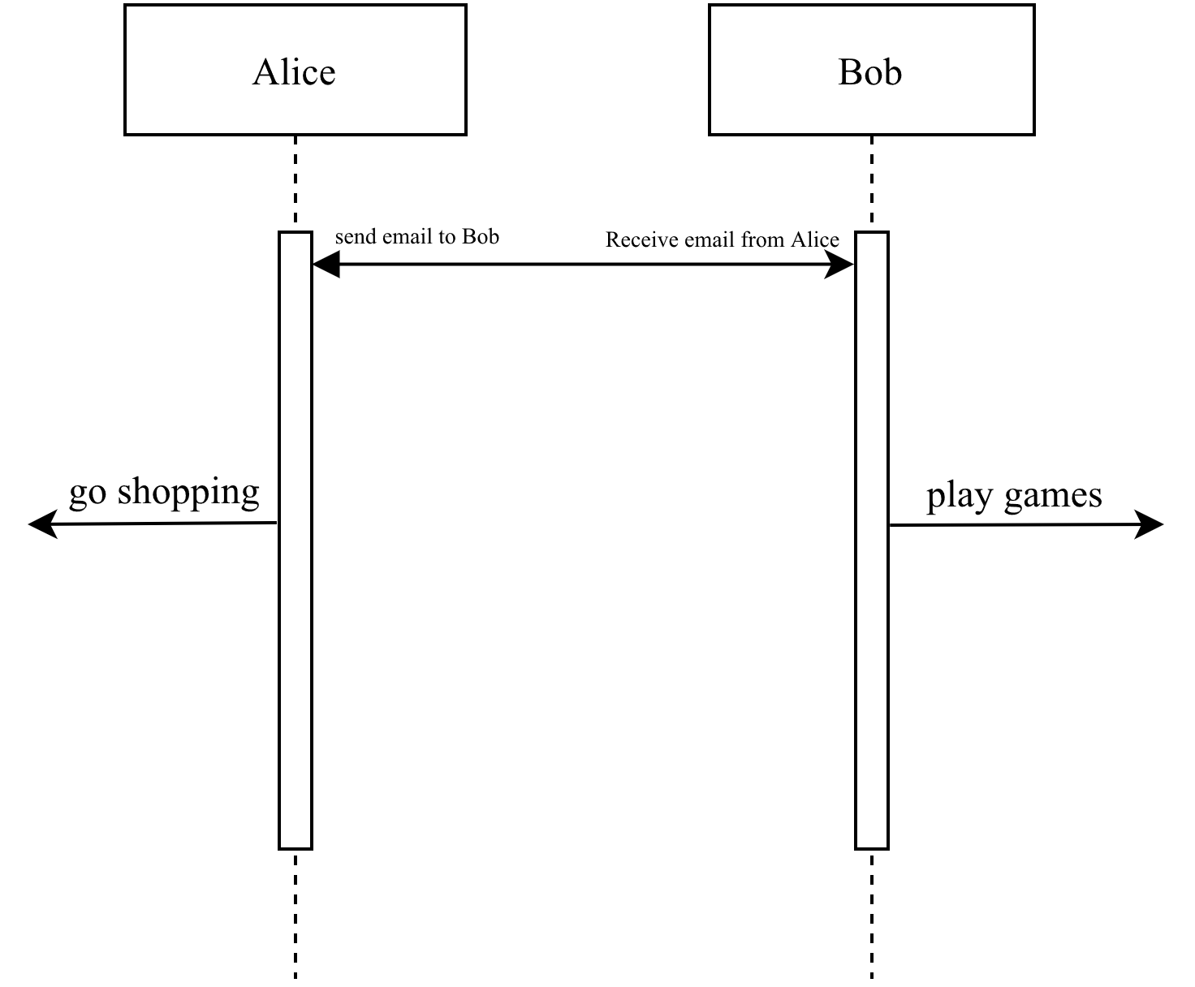
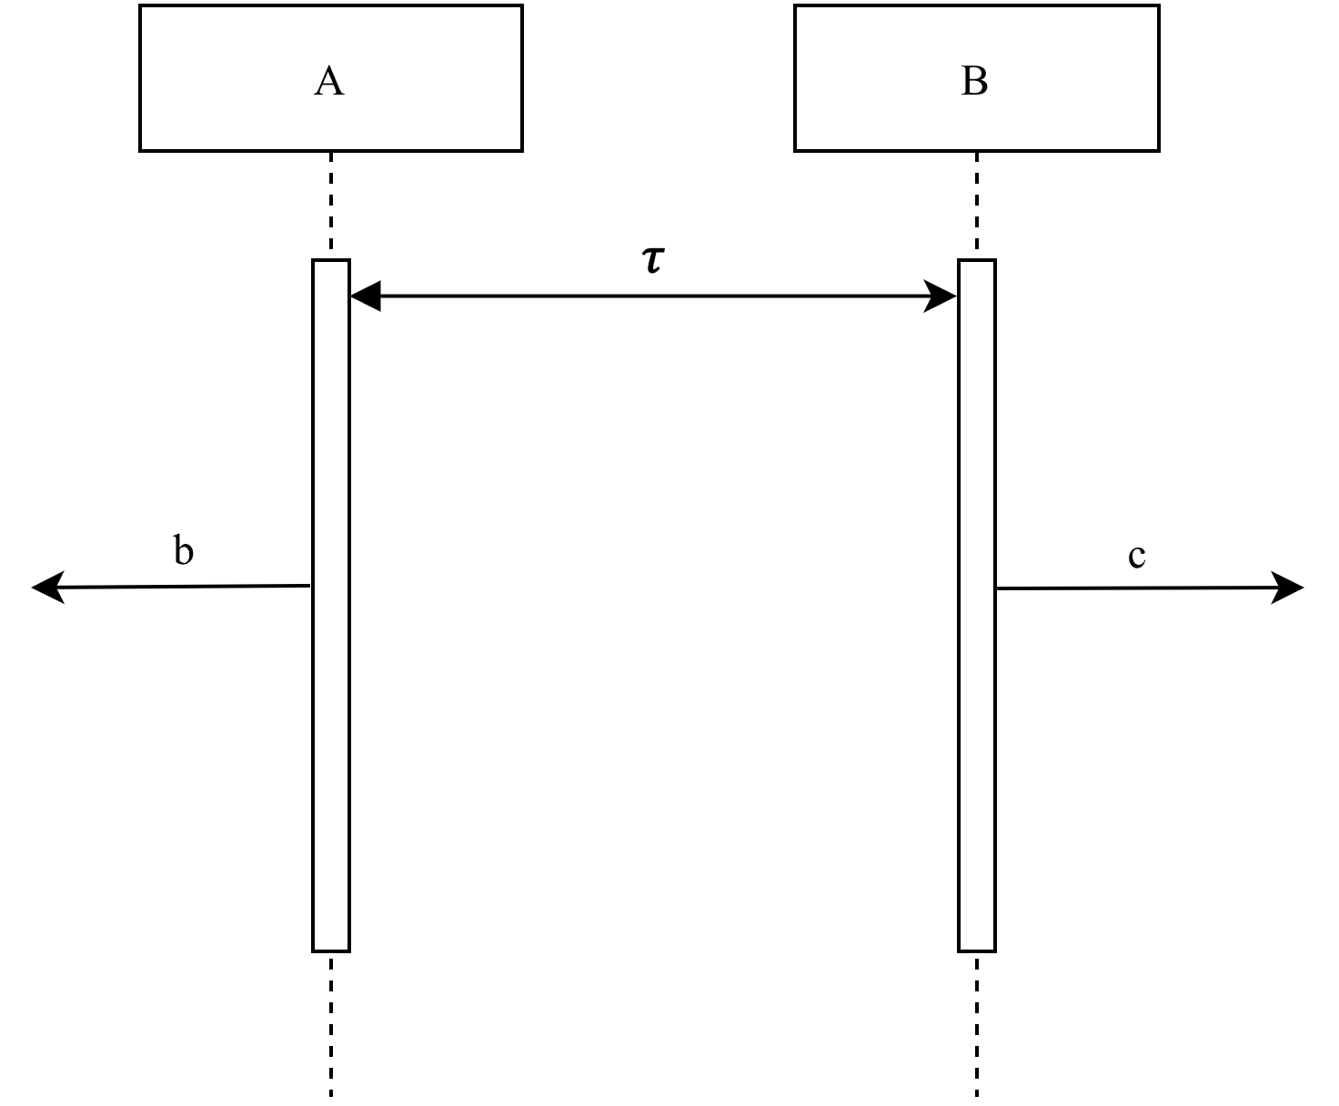
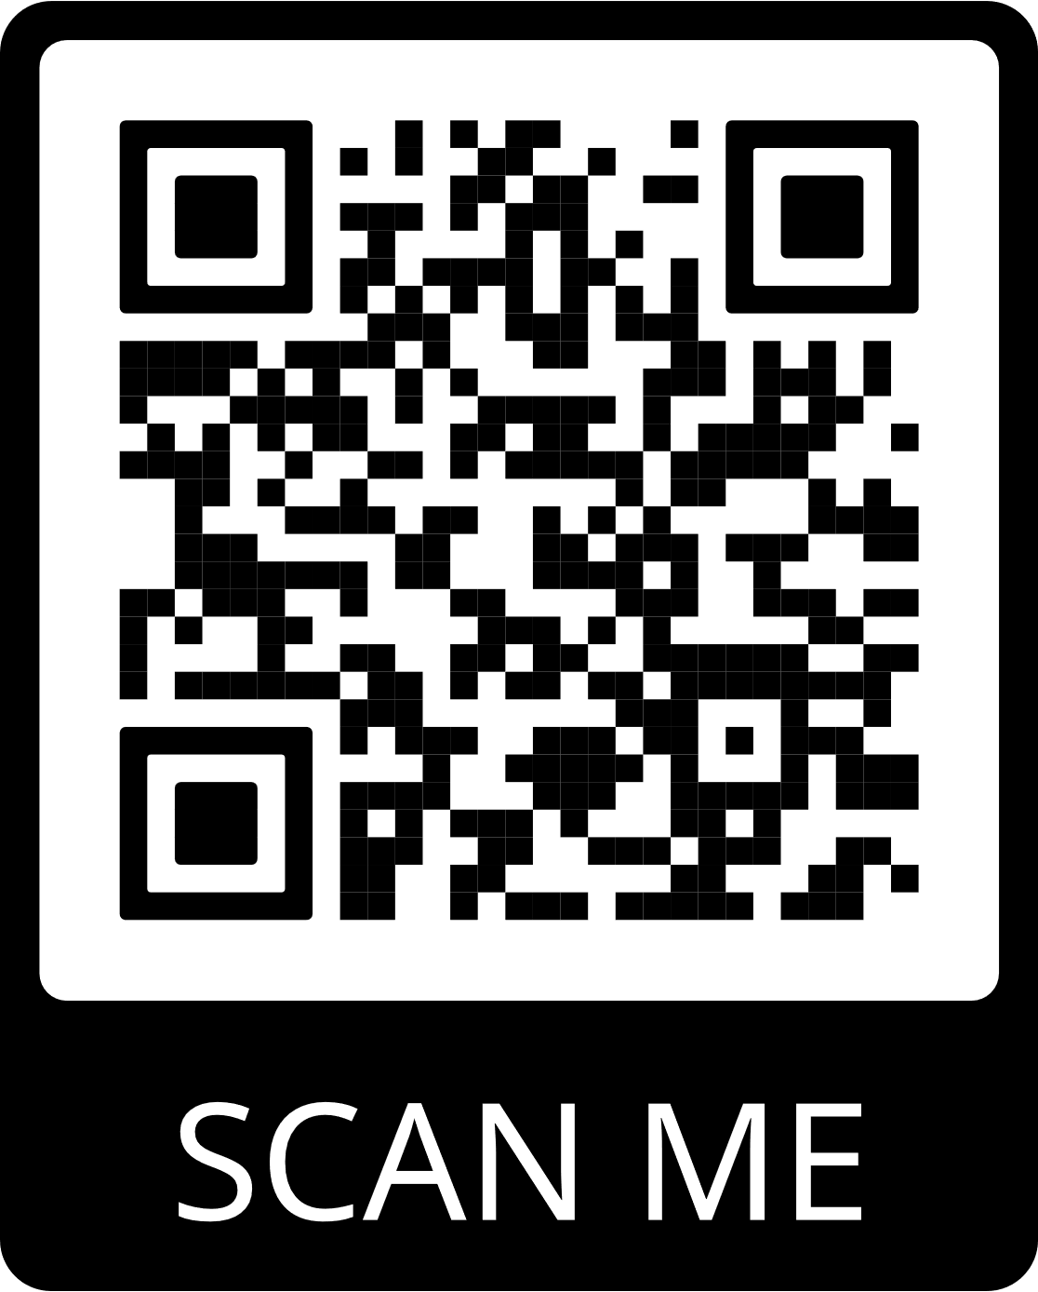
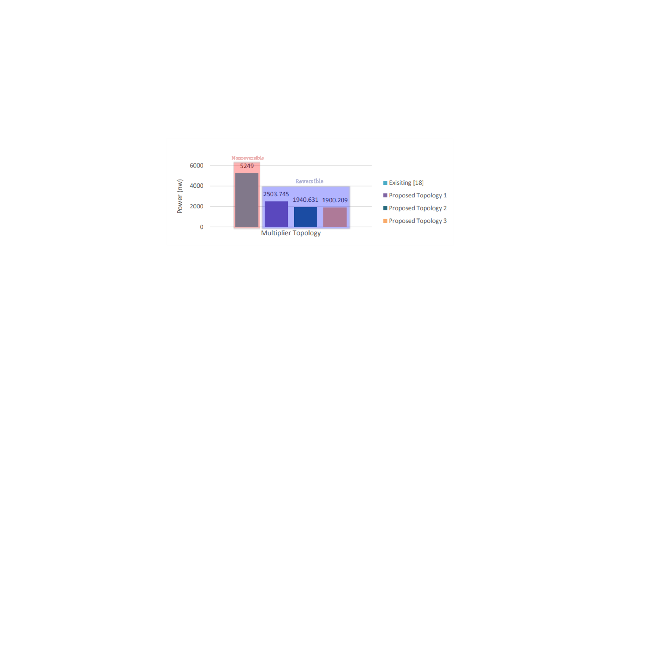
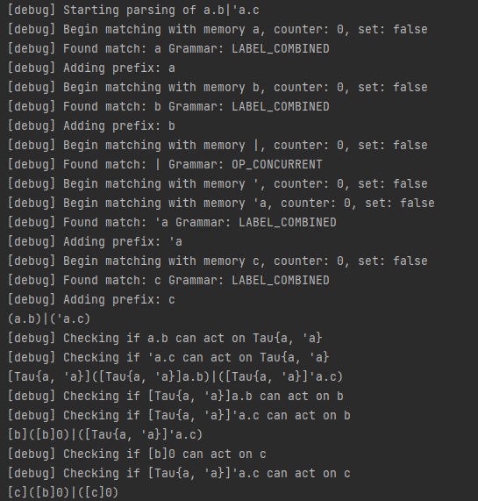
Implementing Distributed Reversible Computation
Peter Browning¹ , Clément Aubert¹
Augusta University¹
What is it?
Abstracting away complexities
What’s next?
Computers need to communicate
How can we verify that communicating systems work the way they should?
Calculus of Communicating Systems (CCS) models their correctness
We can unravel processes into Petri nets. In reversible systems, we can observe the following:
New features
Documentation
CCS Extensions
Program Equivalences
Cat = ( sleep + eat )
Person = ( walk | talk )
Vending machine = ( receive money . give drink )
Alice = (send email . go shopping) → Alice = (a . b )
Bob = ( receive email . play games) → Bob = ( ā . c )
Represented as a sequential diagram:
Conclusion
Distributed reversibility is viable
Our program may server as a base for future reversible protocols
You can view the source code here:
Implementation
Why do we care about reversibility?
First public program to implement a reversible form of CCS
Coded completely from scratch, including string and parsing libraries
~3.5k lines of code, fully open source.
Implements all the core components of CCS(K):
References
Capability to reverse cryptographic functions
“Rewind” a computer that was compromised
Reversible cryptography
Computers are natively capable of reverse program flow, removing the need to manually implement it
Energy efficient adiabatic circuits
Eva Graversen, Iain Phillips, Nobuko Yoshida:Event Structure Semantics of (controlled) Reversible CCS. RC 2018: 102-122
Ivan Lanese, Iain Phillips. Forward-Reverse Observational Equivalences in CCSK. RC 2021 - 13th Conference on Reversible Computation, Jul 2021, Nagoya, Japan. pp.126 - 143, ff10.1007/978-3-030-79837-6_8ff. ffhal-03338669f
N Radha and M Maheswari 2020 J. Phys.: Conf. Ser. 1706 012066
Operator precedence
Summation
Concurrency
Action prefixing
Tau synchronizations
Full-scope key-based reversibility
Restrictions
Tokenized processes
Acknowledgements
Thank you to the following for the help and support:
Dr. Clément Aubert, Dr. St Louis, Dr. Quentin Davis, Augusta University CURS.

