Slide 1
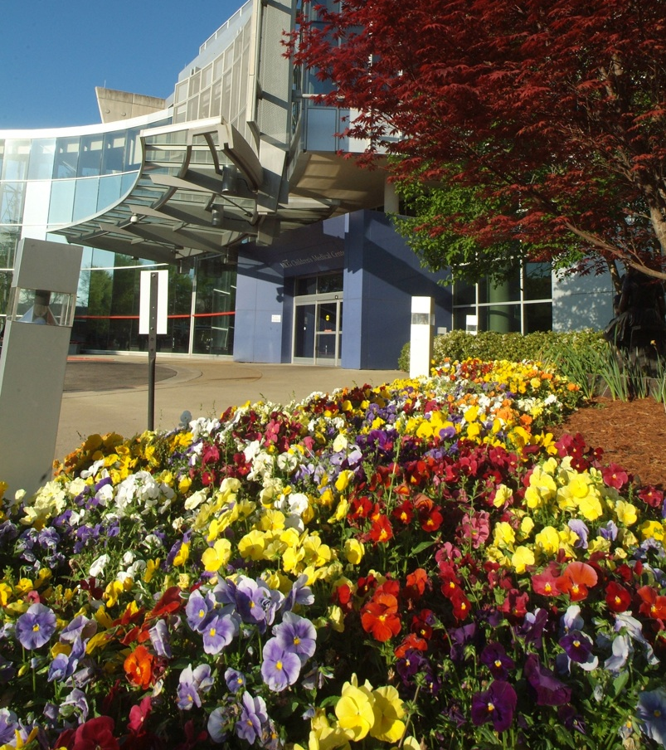
An Imperfect Science: Bridging the Gap
Katie McKie, MD
Jan 2026

Slide 2
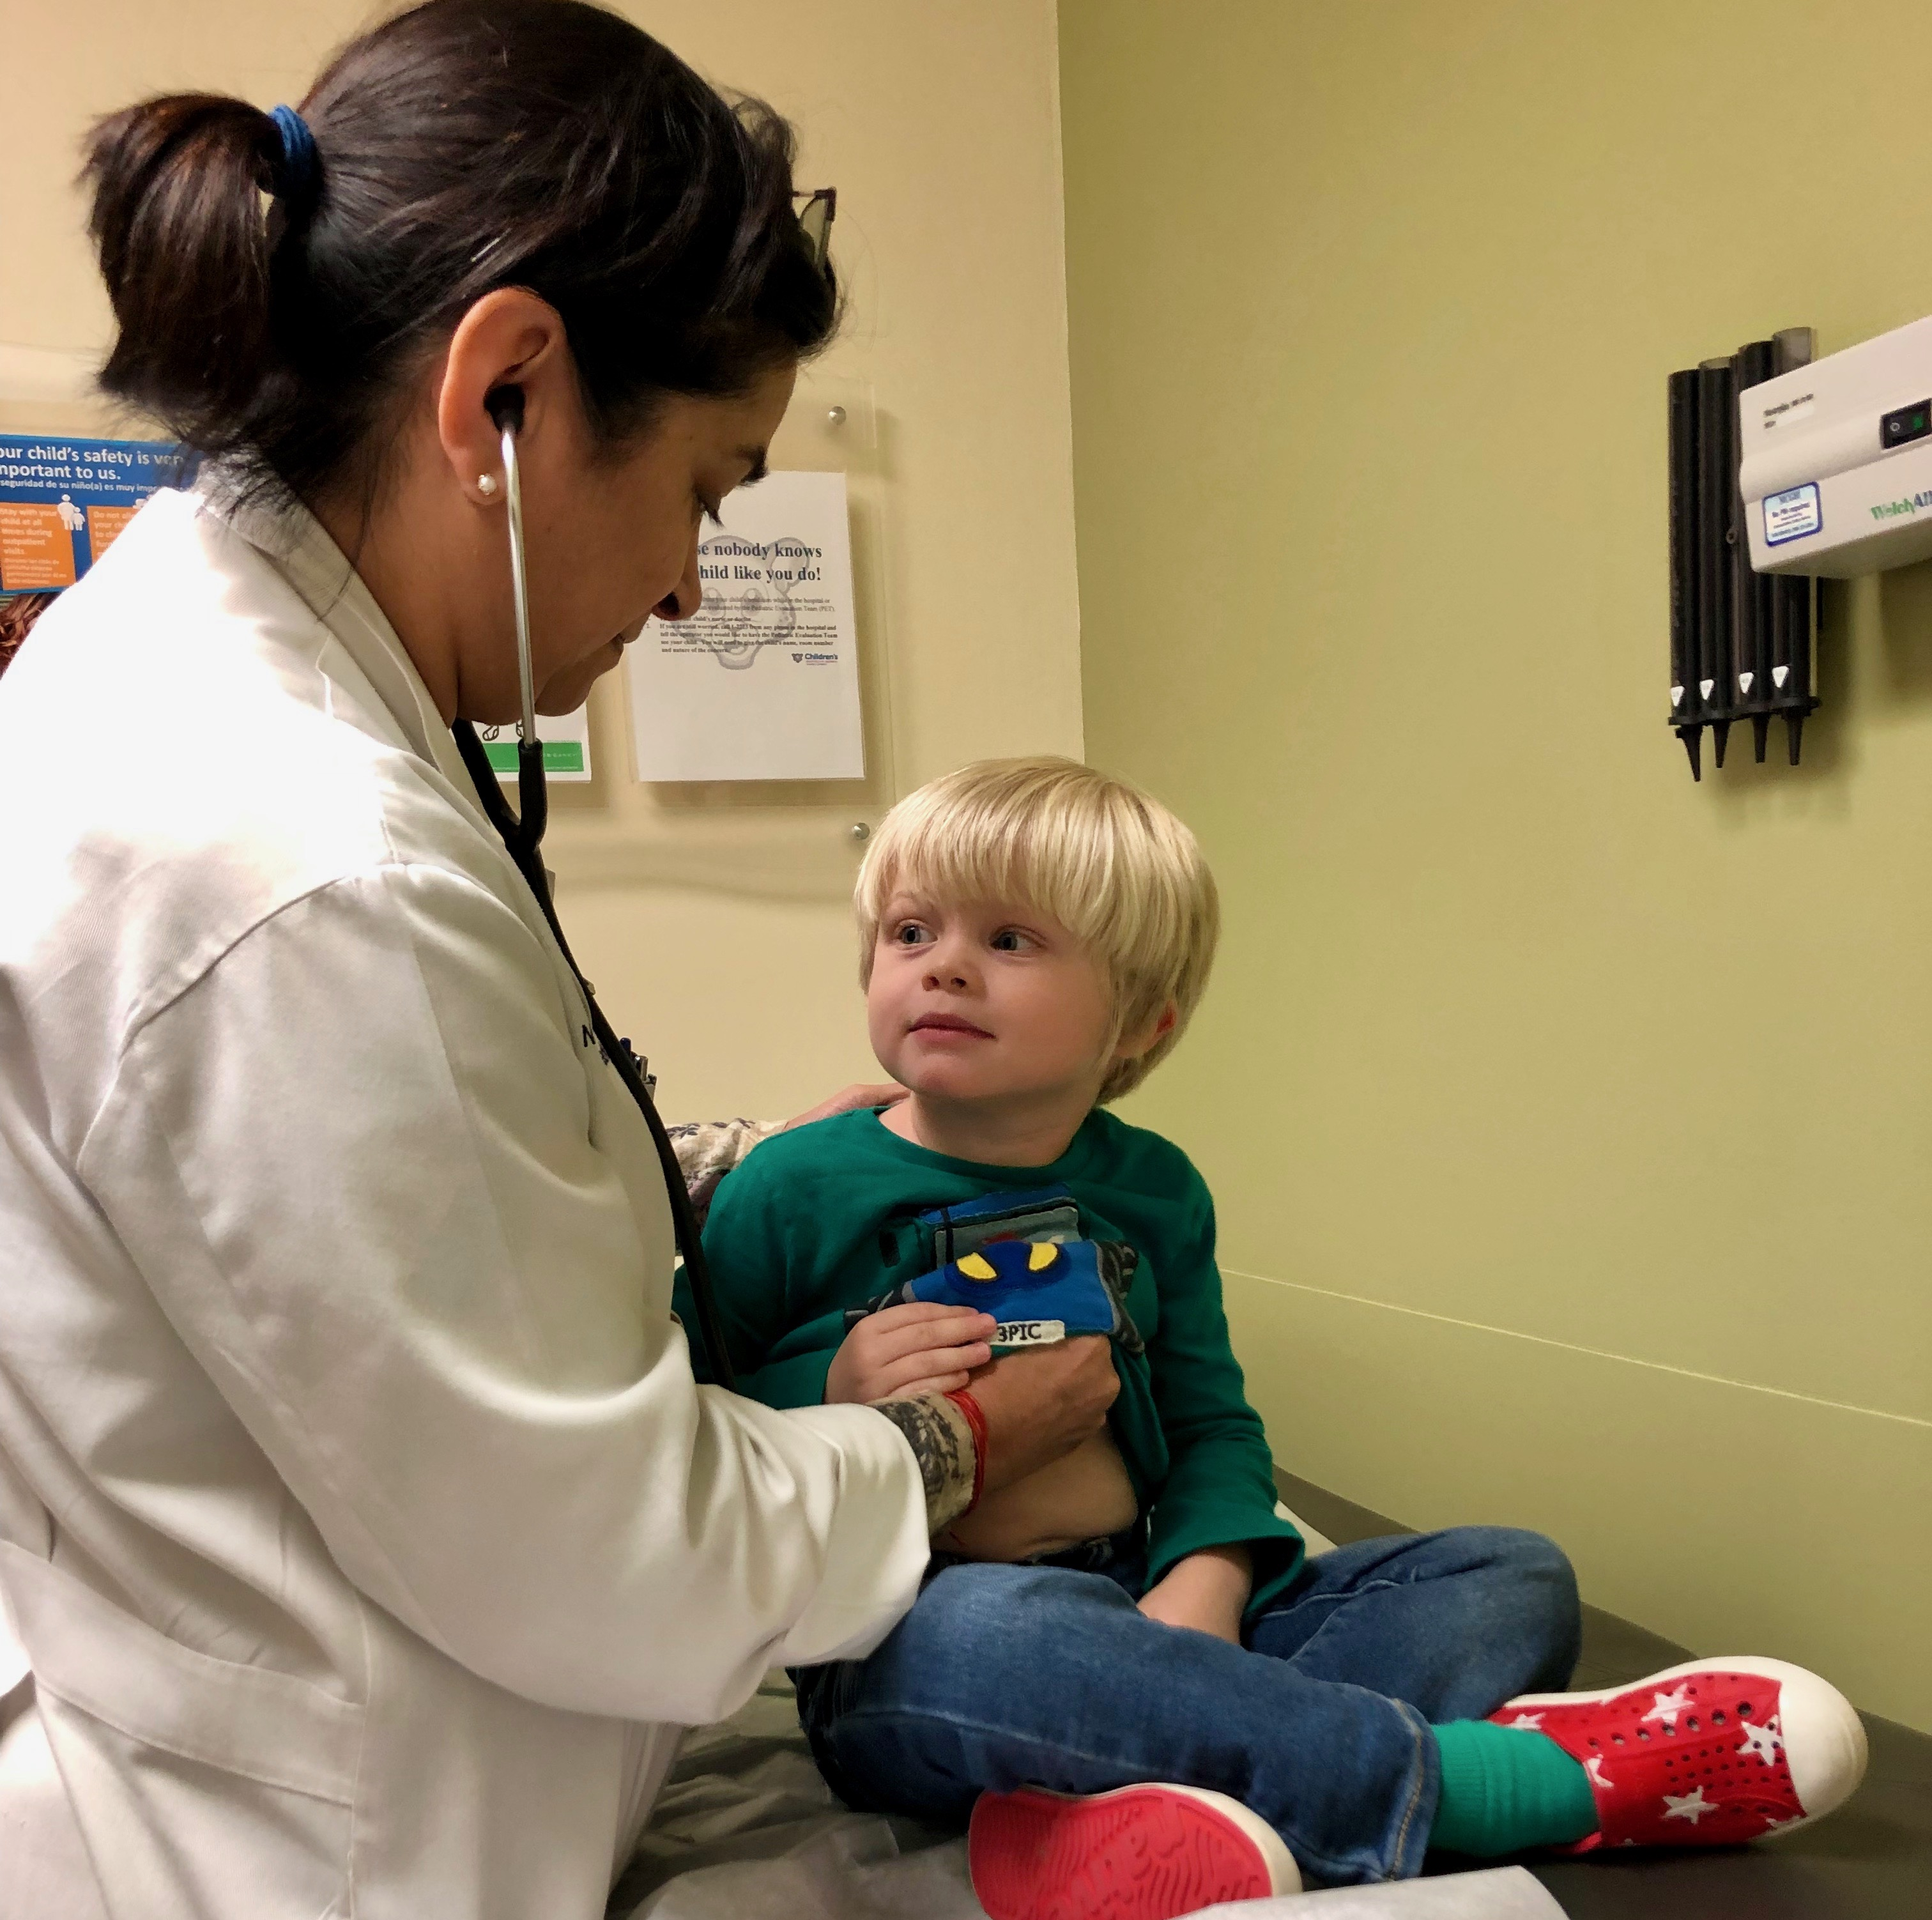
“We look for medicine to be an orderly field of knowledge and procedure. But it is not. It is an imperfect science, an enterprise of constantly changing knowledge, uncertain information, fallible individuals, and at the same time lives on the line. There is science in what we do, yes, but also habit, intuition, and sometimes plain old guessing. The gap between what we know and what we aim for persists. And this gap complicates everything we do.”
― Atul Gawande, Complications: A Surgeon's Notes on an Imperfect Science

Slide 3
Making the invisible visible
How do you become an academic physician?
What’s different about academic medicine compared to community practice?
What is the structure of the medical team?
What do you do all day?
What different roles do you have?
What types of learners do you have? How do you teach?
What is fun about your job? What is not so fun?
How is my faculty position similar or different from yours?
What can we learn from each other?

Slide 4
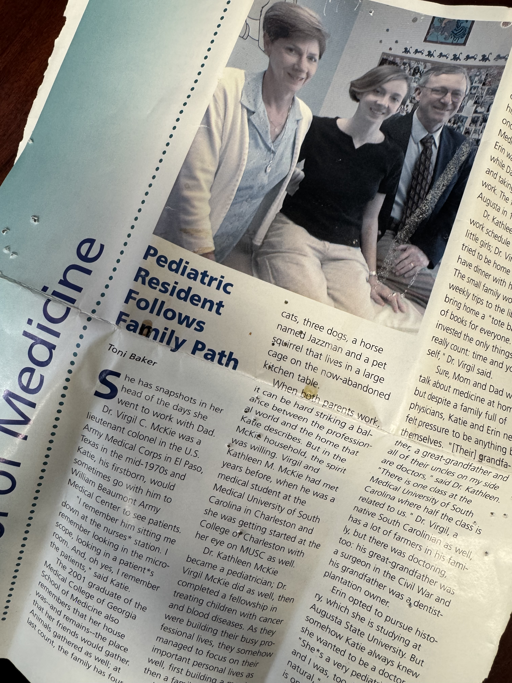
Path to academic medicine
Undergrad
Med school (MD/DO) 4 (3?) yrs
Internship/residency 3-7 yrs
USMLE (Step) exams x 3
? Chief residency 1 yr
+/- Fellowship 1-3 years
Board exams – specialty & subspec
Assistant professor (tenure/ non-tenure, clinician/educator/investigator)
Associate professor
Professor

Slide 5
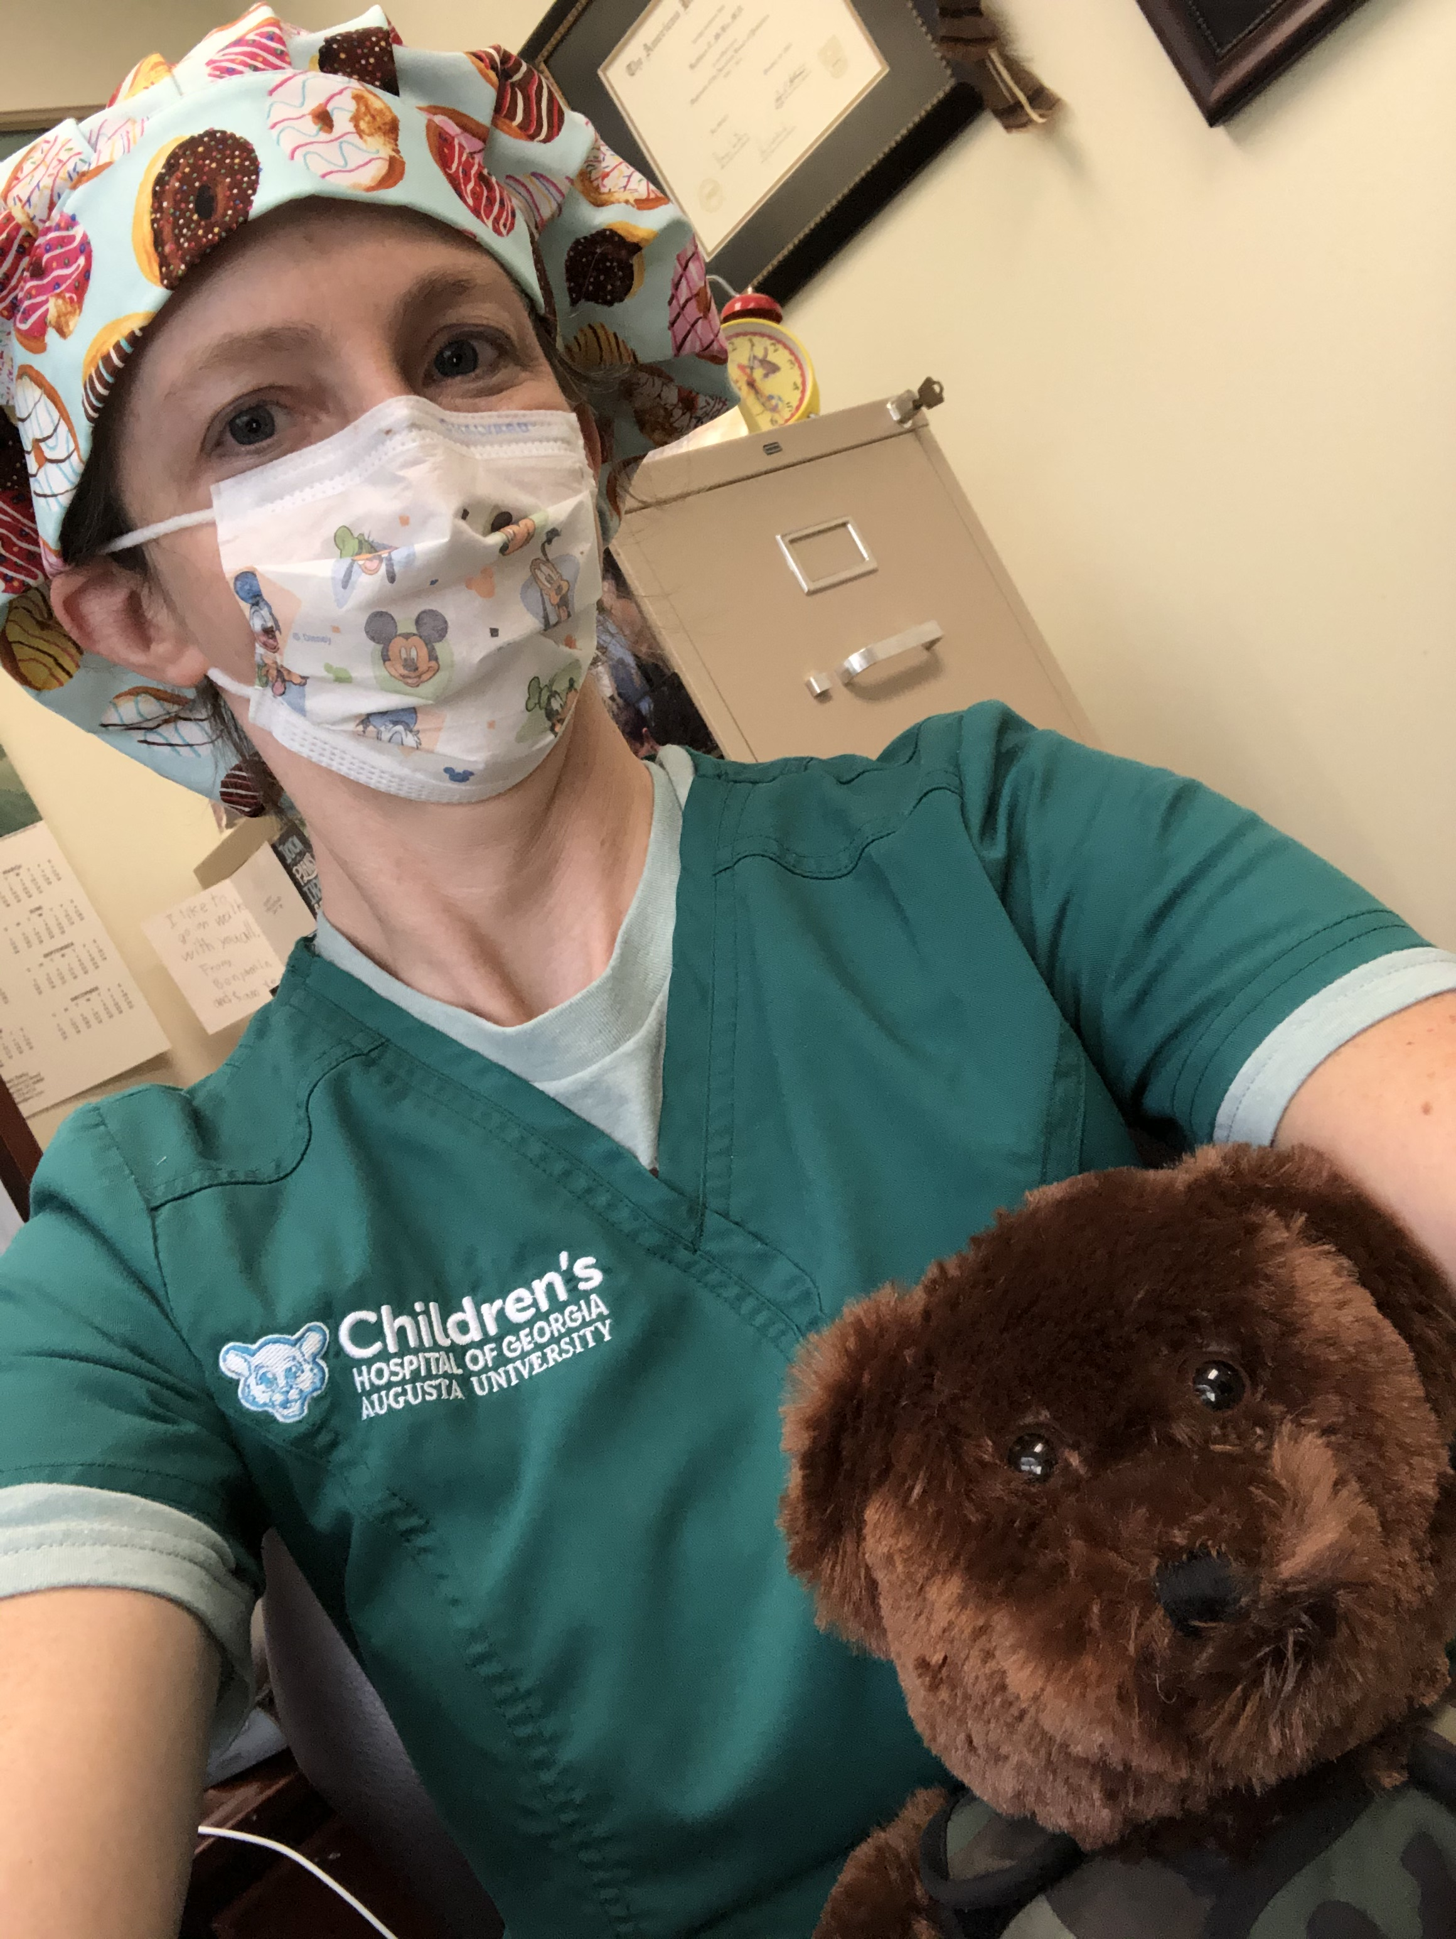
About me
Medical College of Georgia
MCG Pediatric Residency
MCG Peds Chief Residency
MCG Peds - Assoc Prof Peds & Sleep Medicine
Cystic Fibrosis Center co-director
Approx 65% clinical, 15% research, 10% teaching, 10% service
(and 100% mom to 2 boys)

Slide 6
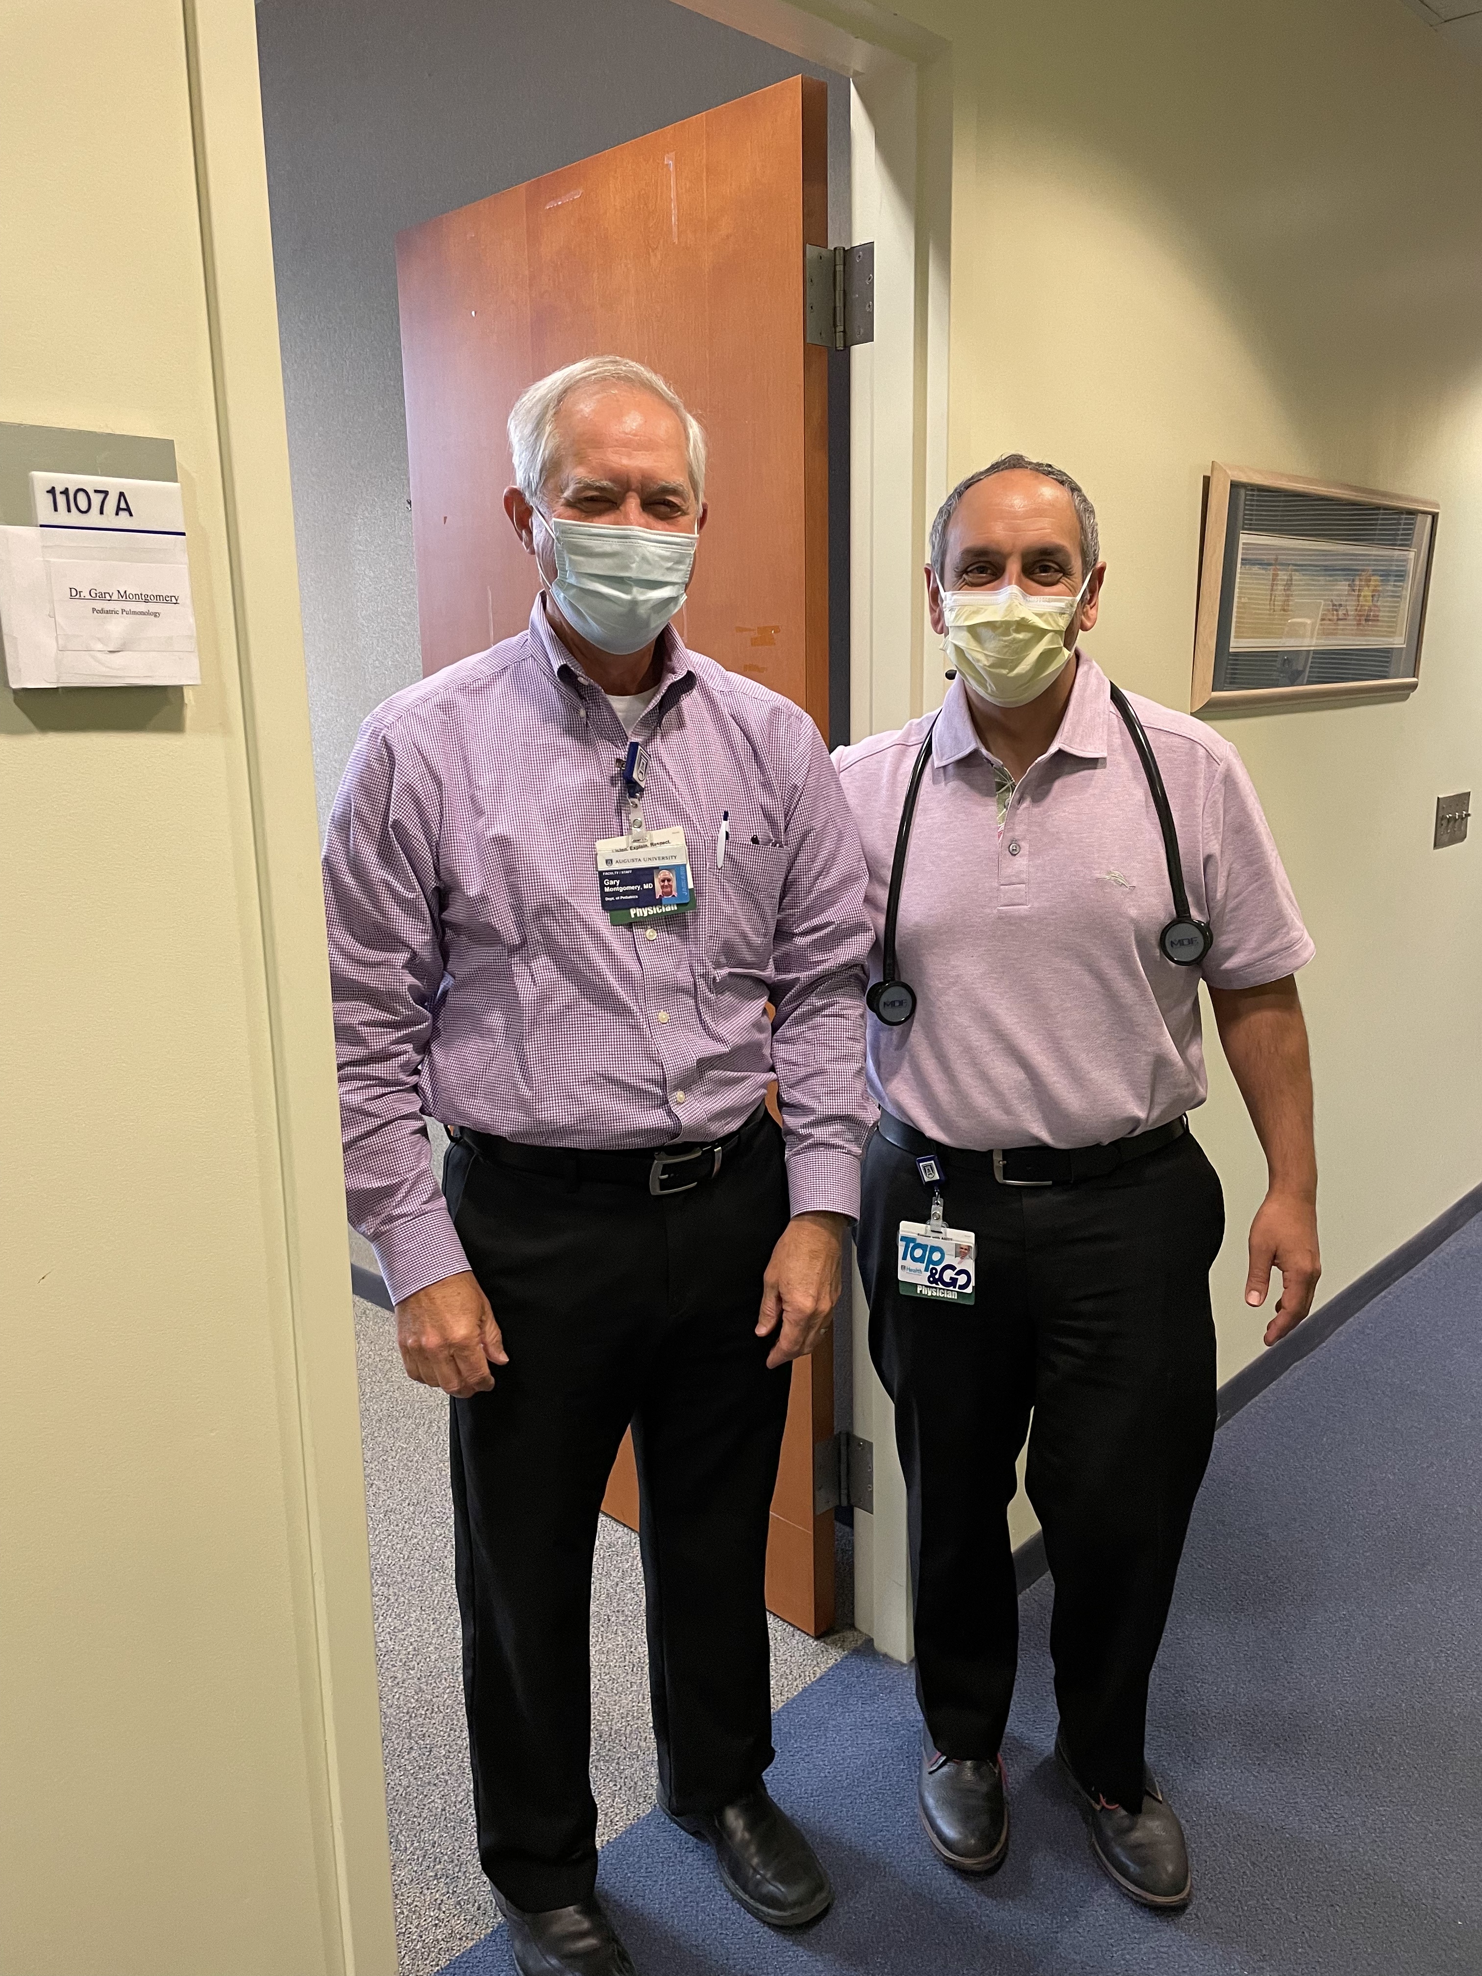
What’s different about academic medicine?
Clinical care
Education
Research

Slide 7
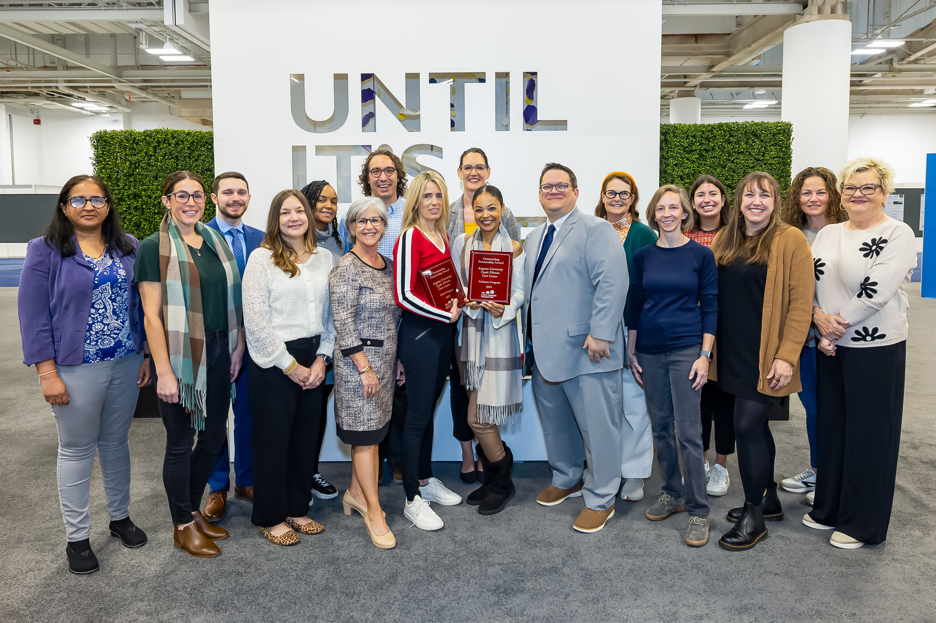
It’s a team sport
Multi-disciplinary
Physicians, mid-level providers, nurses, pharmacists, respiratory therapists, dietitians, physical therapists, psychologists, genetic counselors, social workers, etc
Patients/family members

Slide 8
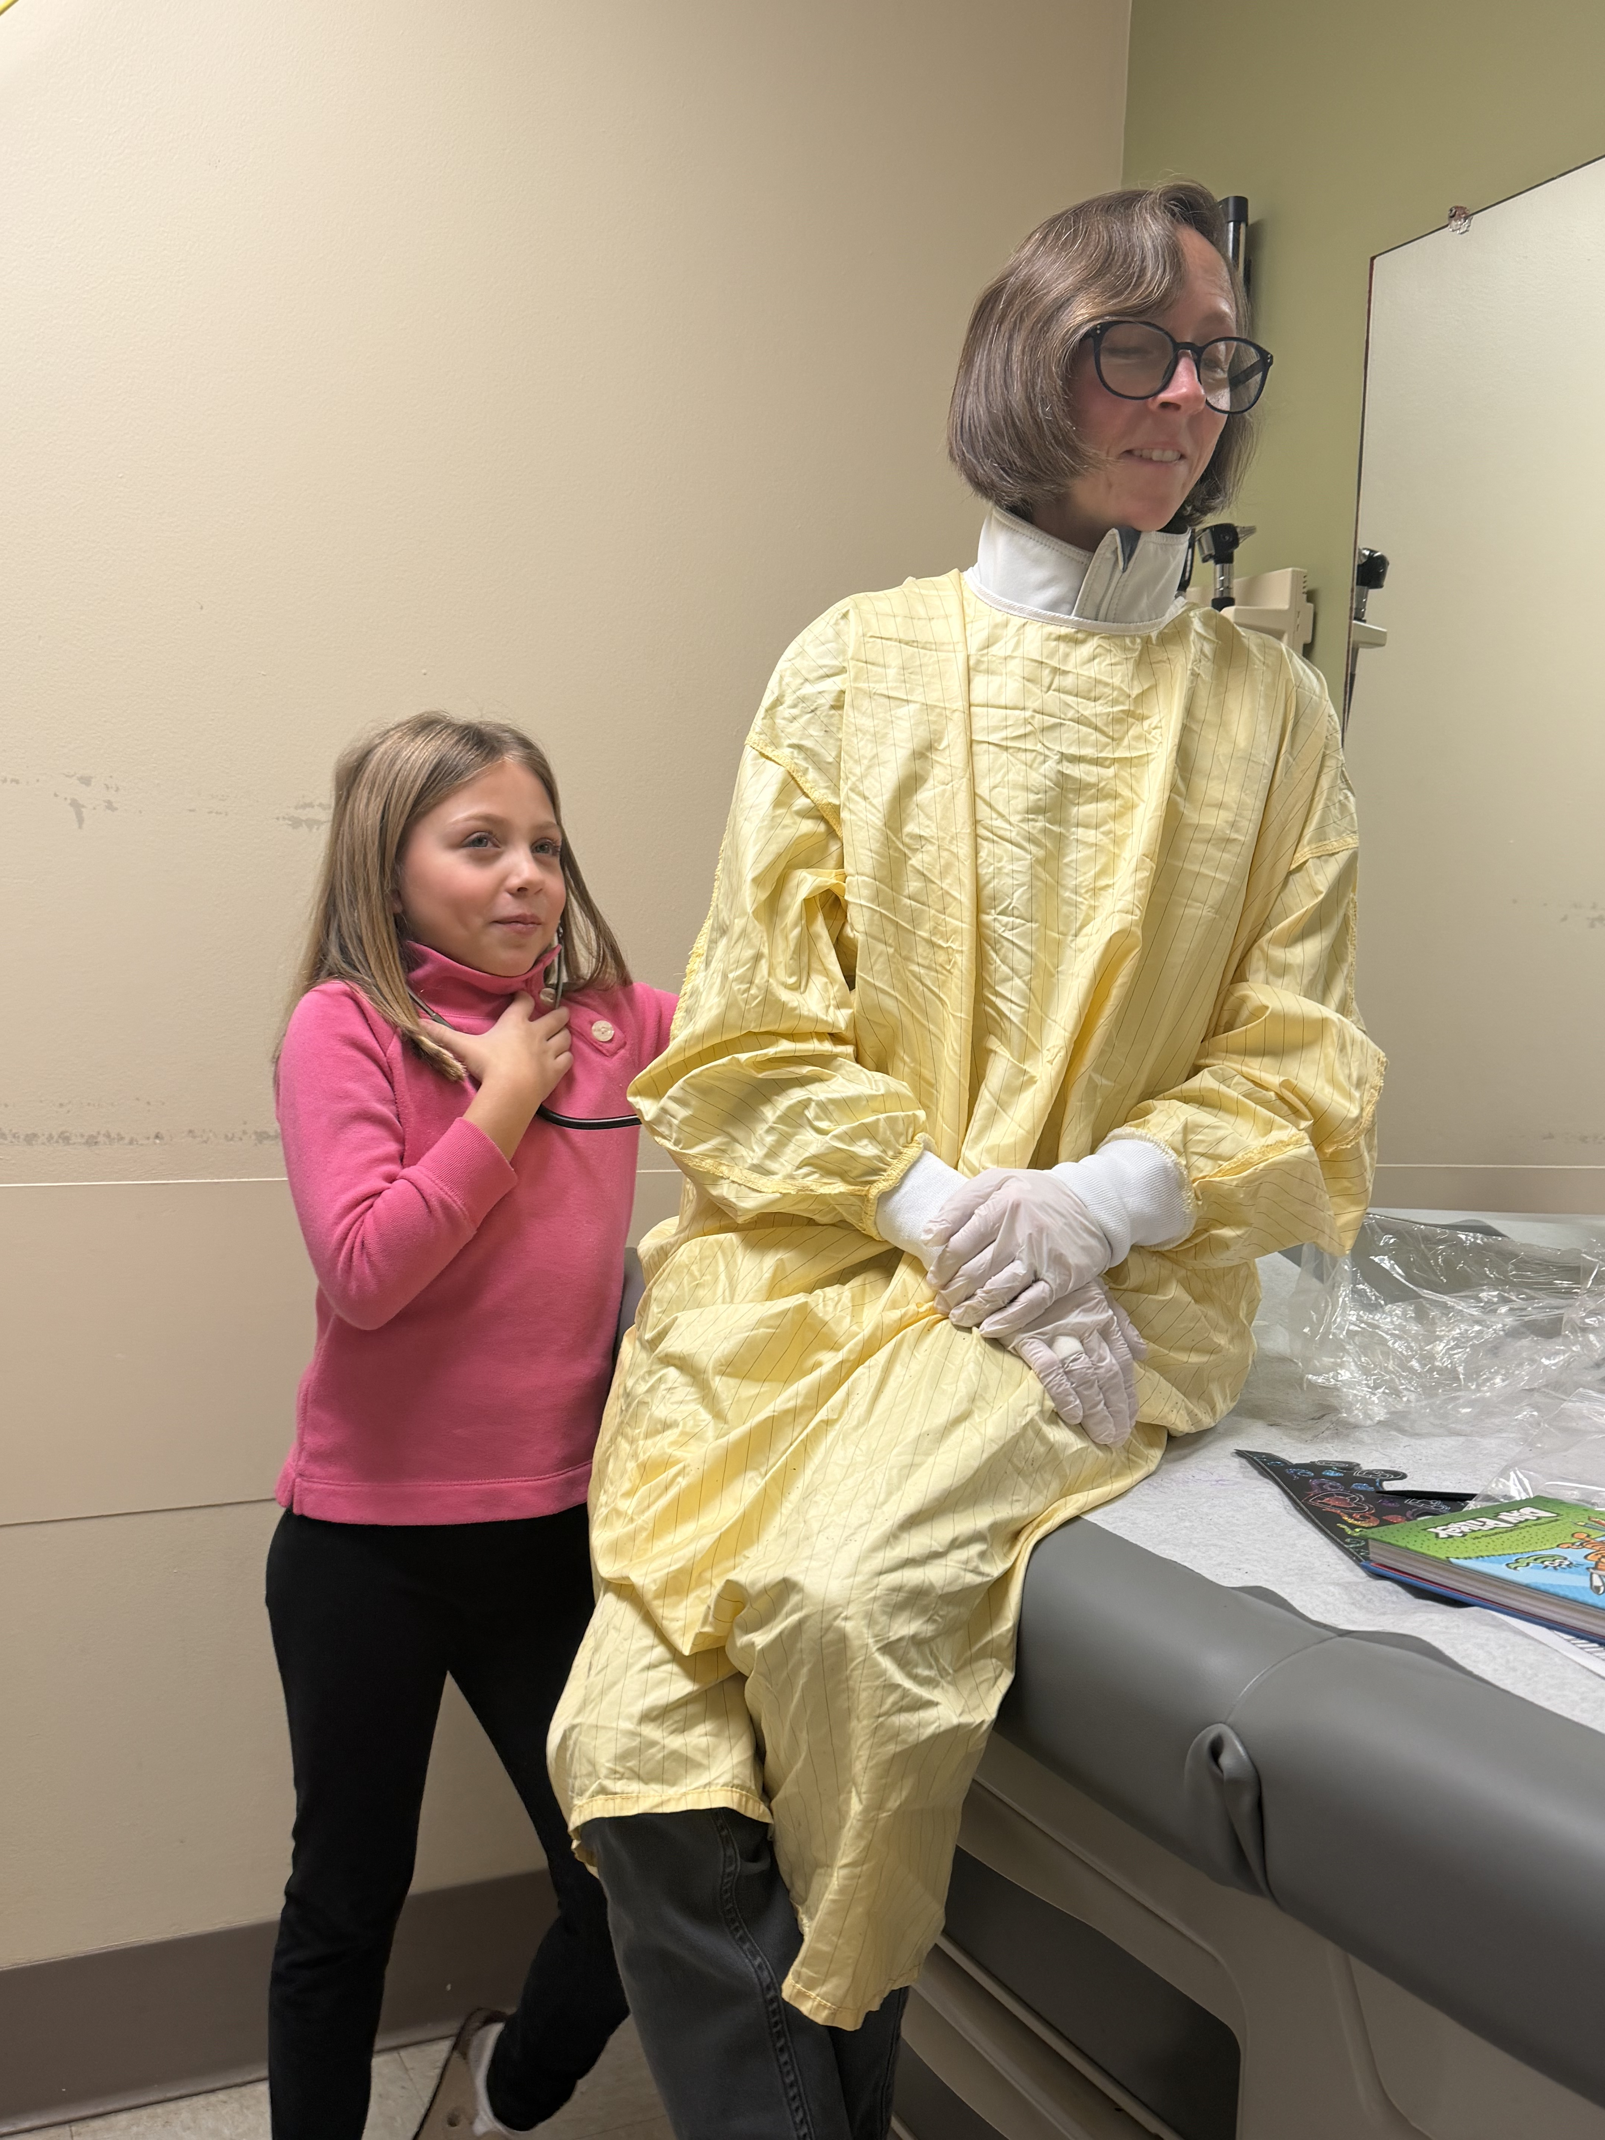
Clinical care
Patients in clinic – asthma, CF, sleep, BPD etc
Patients in the hospital
Telemedicine
Sleep studies
Call
Documentation
*these have all changed a lot over the years – in some ways better/in some ways worse?
Notes:
Emphasis on productivity, EMR, AI, complexity of patients, acuity, work hour rules

Slide 9
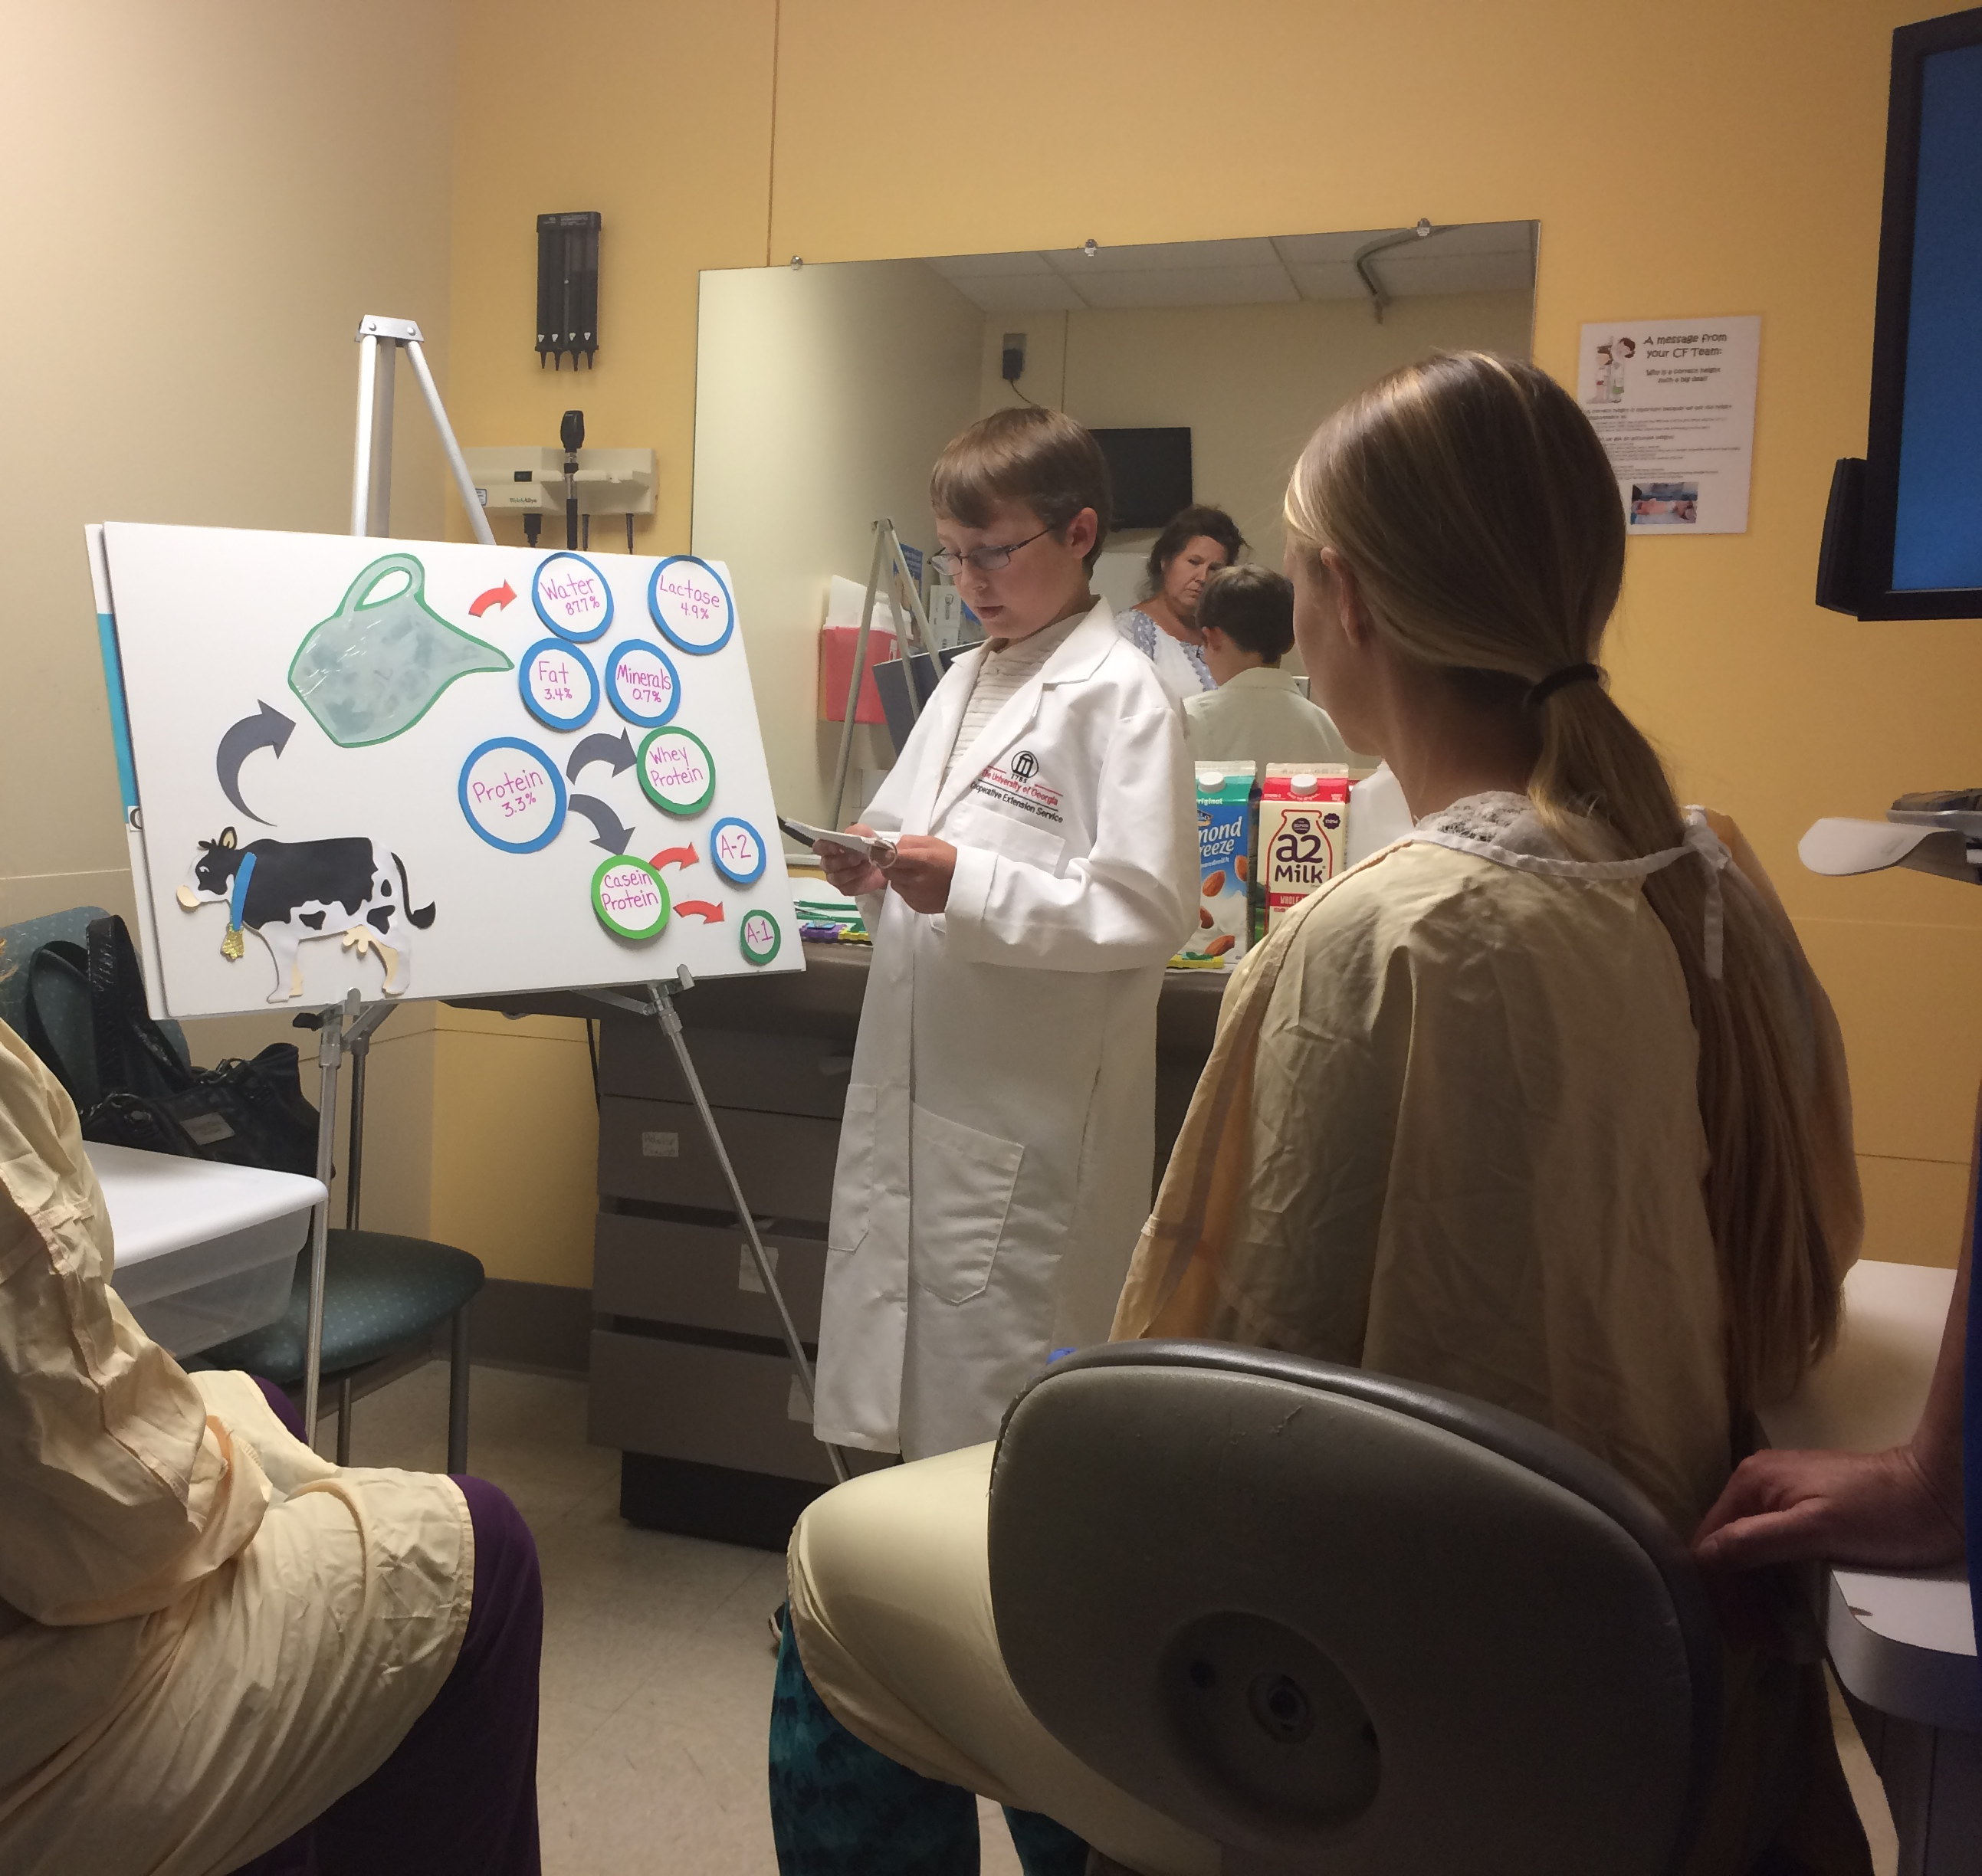
Education – see one, do one, teach one
Bedside teaching (in clinic and in the hospital) – med students, residents, fellows, observers
Didactic lectures
Advising (med students, residents, fellows, new faculty)
Fellowship
Educating patients

Slide 10
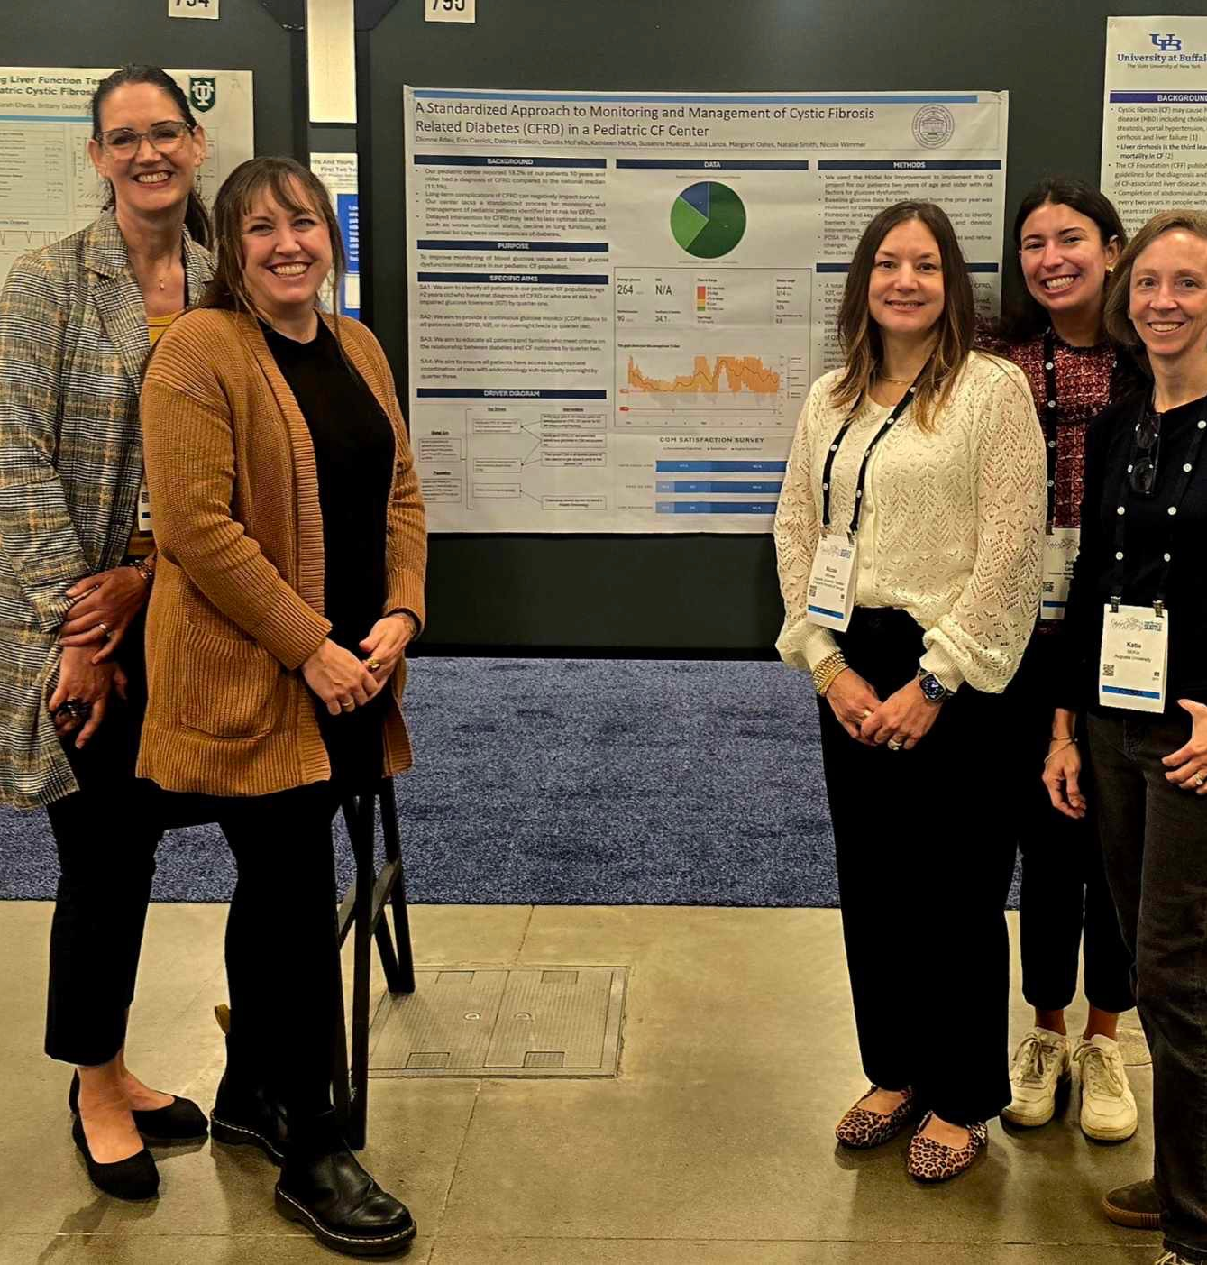
Scholarship
Bench research
Clinical trials
Investigator initiated studies
Quality improvement
Mentoring students/residents in their scholarly activities
Posters/presentations
Publications

Slide 11
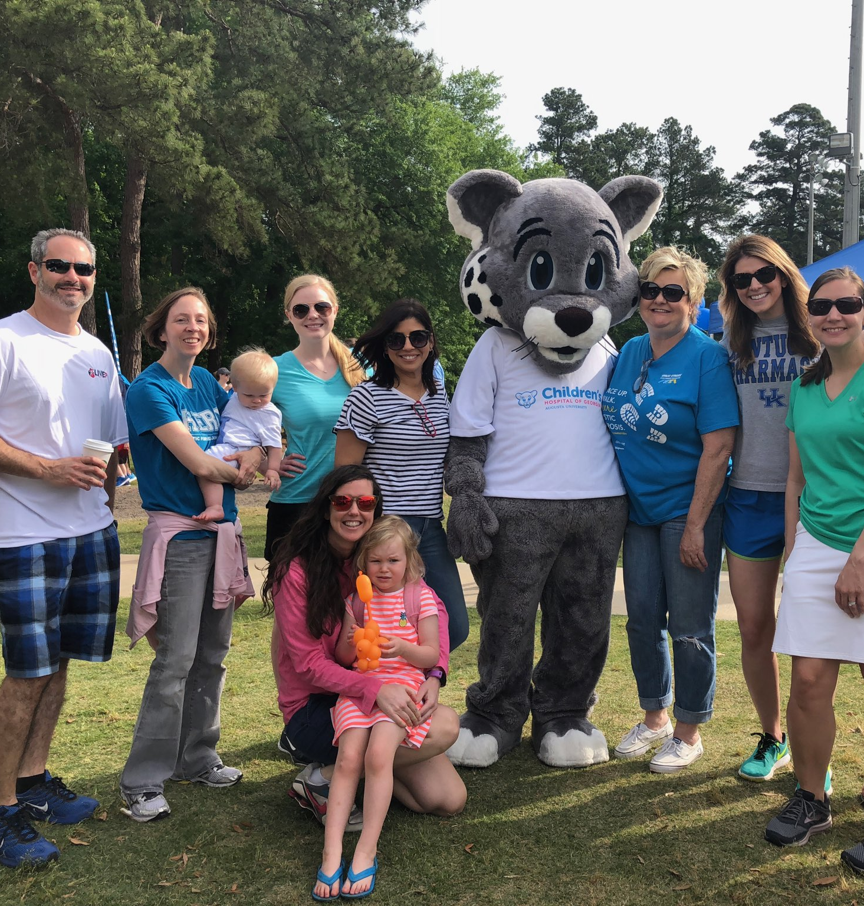
And what about all the other stuff?
Grant applications and management
Budgets
Committees
Call schedules
Evaluations
Recruitment/interviewing
CMEs
Maintenance of certification
Dealing with insurance companies
Community service/philanthropy

Slide 12
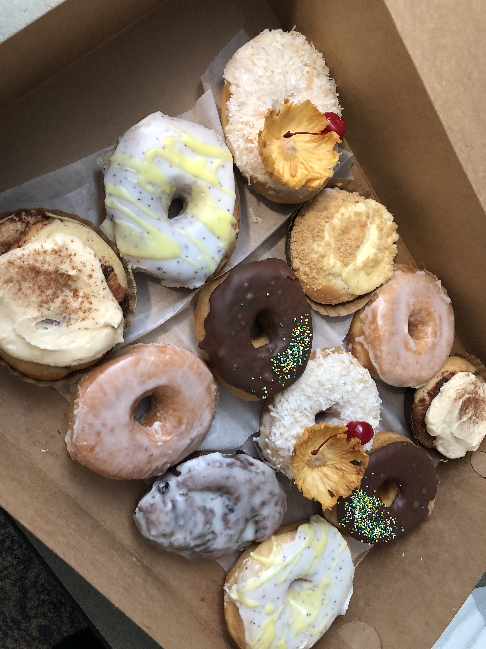
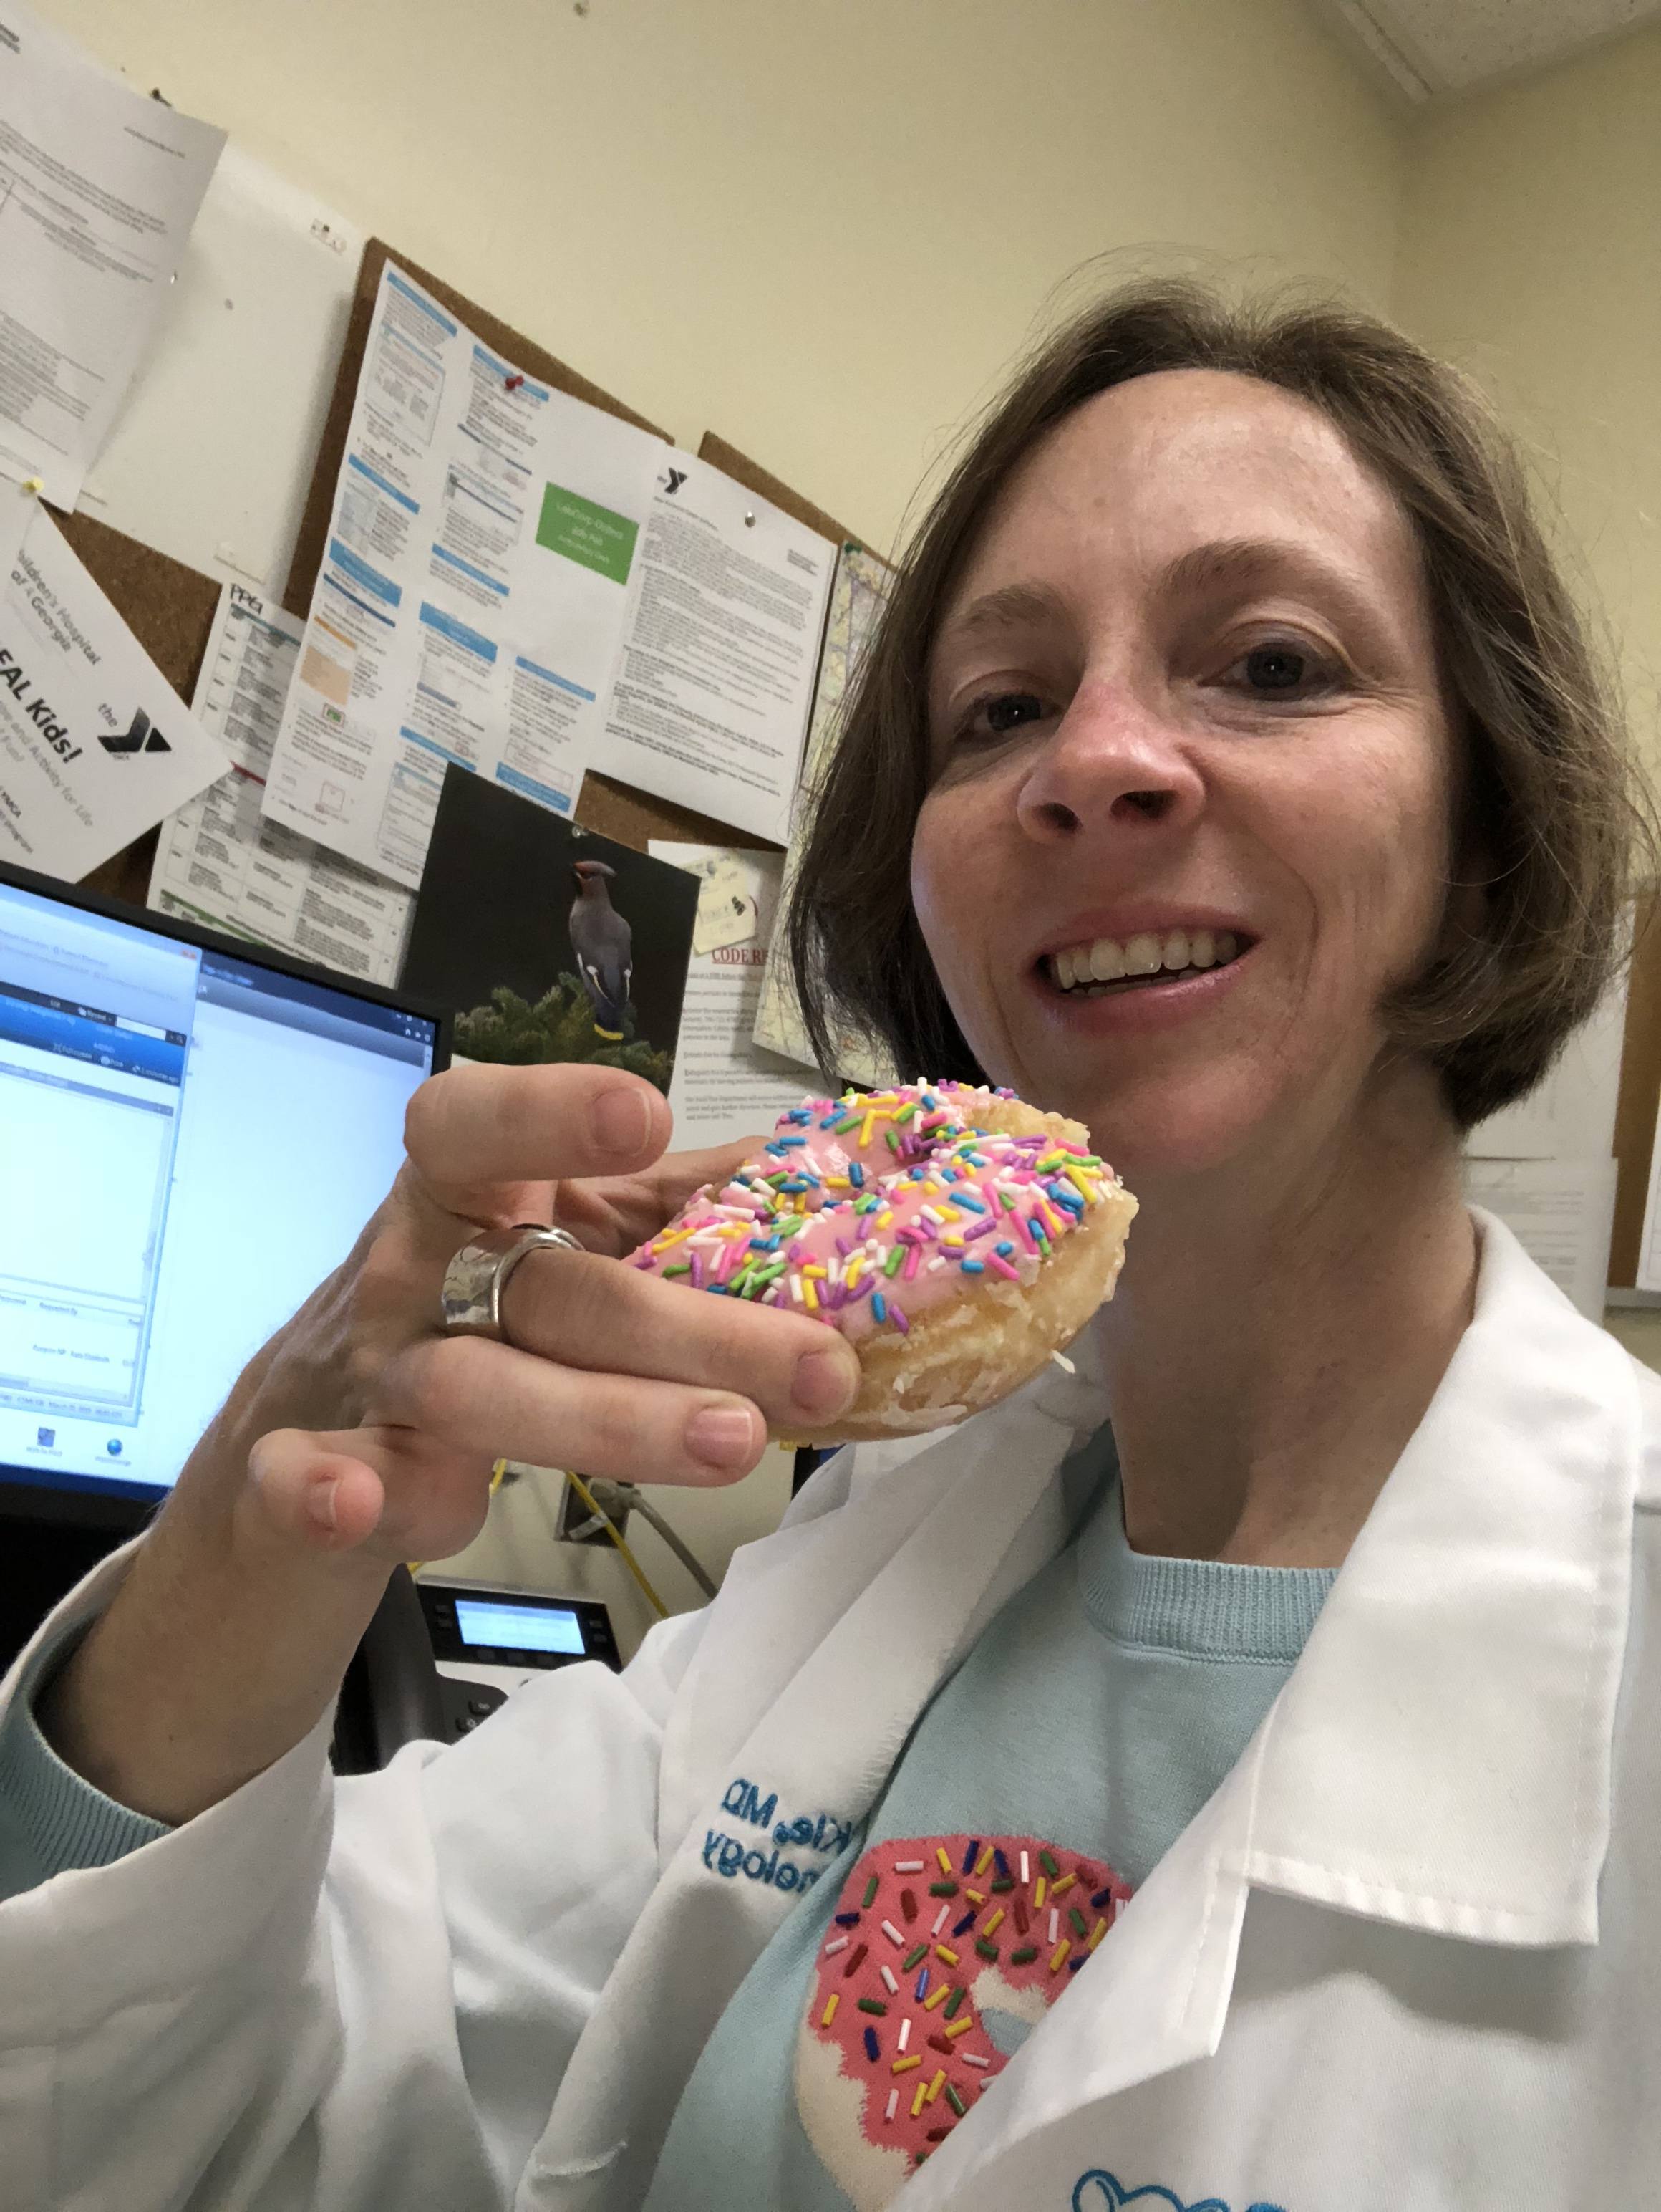
A typical day?
See patients in clinic
Teach
See patients in the hospital
Read sleep studies
Return patient phone calls
Attend a meeting
Catch up on notes

Slide 13
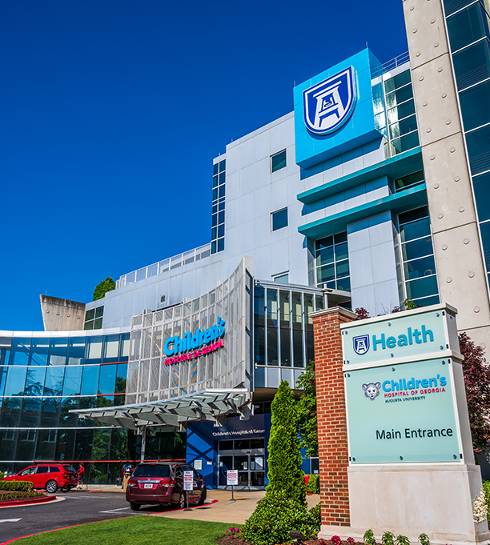
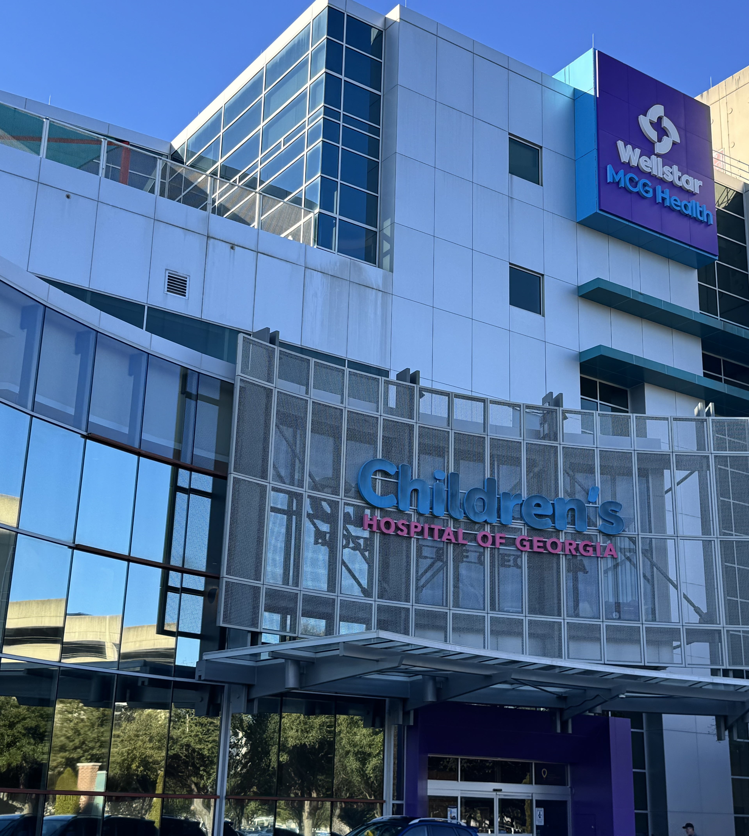
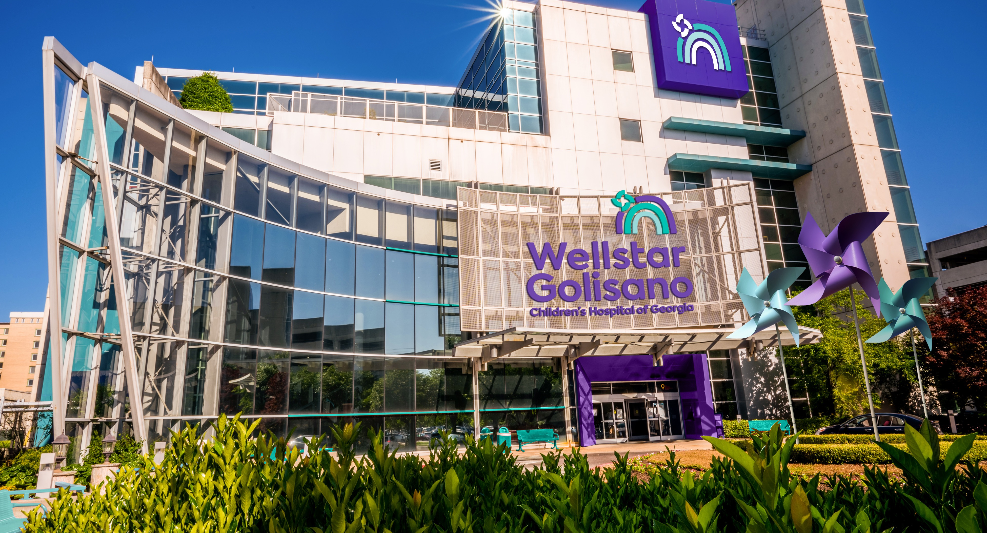
Who do I work for?
AU?
Wellstar?
Insurance companies?
Patients?
Learners?

Slide 14
Instabilities in academic medicine
Gap between best practice and what actually happens
Gap between academic and community practitioners
Impossible to be competent in all 3 areas (patient care, research, teaching)
Less value placed on research and teaching
Financial disincentive
Problems with career progression esp for women
Research often not concerned with the biggest health problems
Inadequate leadership
Poor public perception/ lack of trust

Slide 15
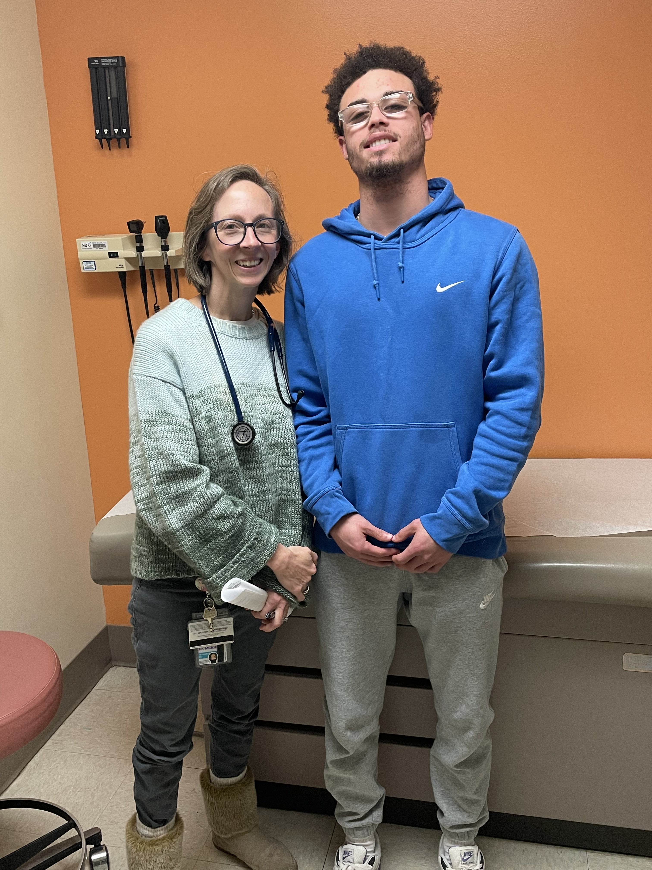
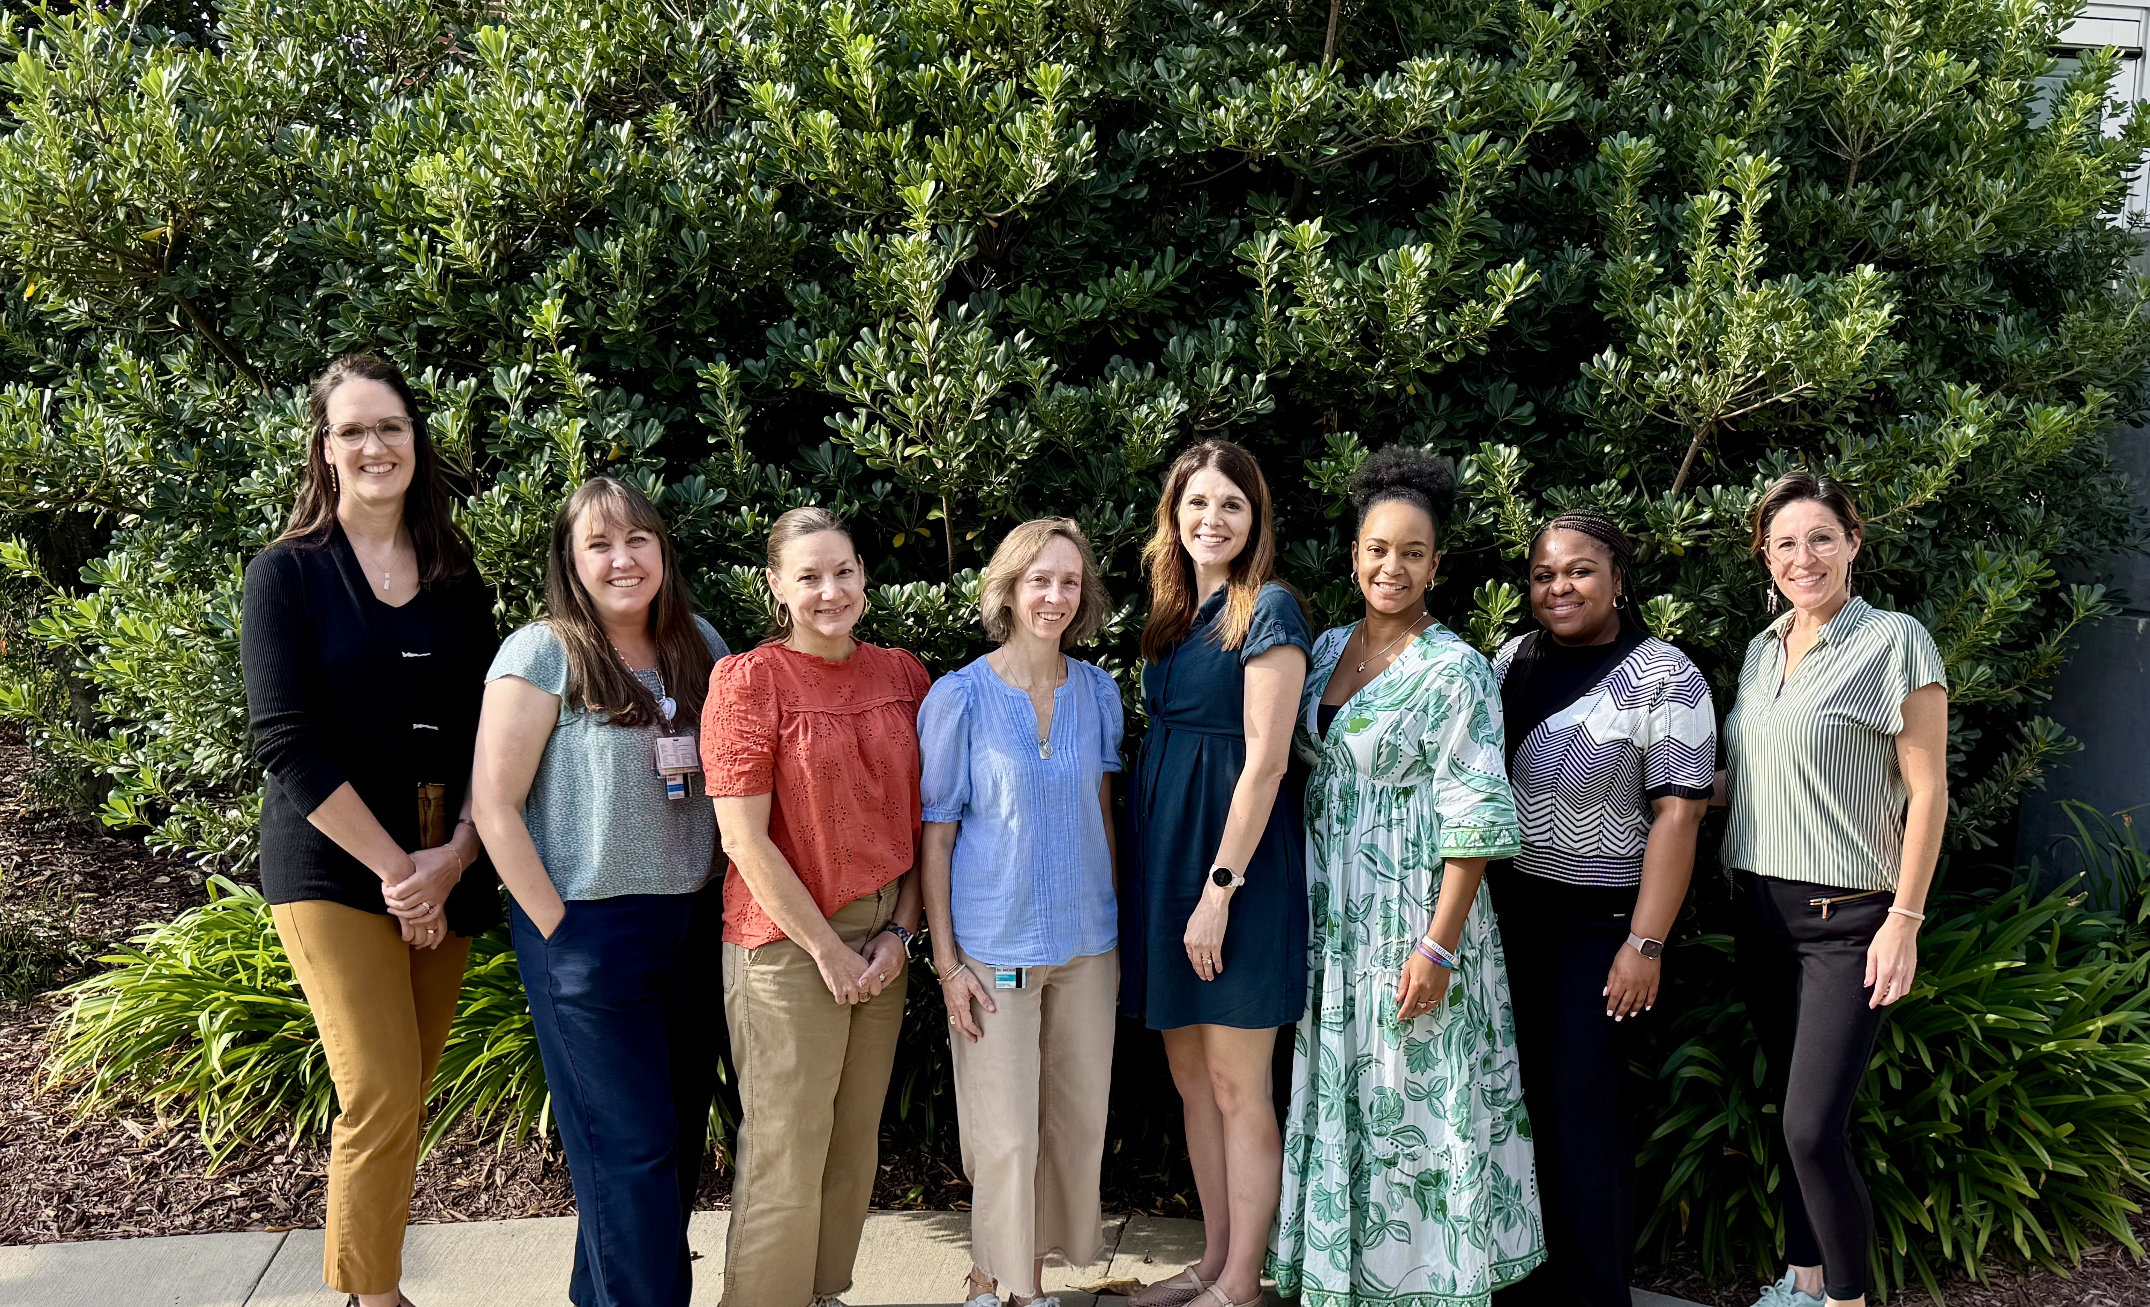
At the end of the day…

