Slide 1
Making the invisible visible: Tips and tools for your writing process
Jamie Garner, PhD
Interim Director
Augusta University Center for Writing Excellence

Slide 2
0. Assumptions and caveats
Writing, especially academic writing, is personal and requires some kind of process. It (usually) doesn’t happen in one sitting, and a single approach doesn’t work for everyone.
Academic fields, disciplines, and genres have unique audience expectations and conventions, and I can’t possibly cover all of them.
Not everything in this presentation will apply to your field or discipline, but I hope there there will be something useful to you.
Feel free to interrupt and ask questions during the slide portions.

Slide 3
Opening question
In keeping with our theme, we in the CWE often talk about our job as trying to “demystify” expectations of academic writing both for faculty and students.
When you first started writing at a more advanced level, whether in graduate school, professionally, or for academic publication, what about that writing mystified you?

Slide 4
Choose your adventure
2. Reference management
3. AI for prewriting
6. Campus resources
4. The CARS model
5. Writing for academic journals
1. General writing productivity advice

Slide 5
1. General writing productivity advice
Talking about writing =/= writing
Figure out when and where you’re most productive.
Start a writing habit. Schedule writing time, even if it’s just 15 minutes. Set aside a certain amount of time per day to write and protect that time.
Start a writing group. (Or join a CWE writing group or get the CWE to help you start a writing group!)
Keep a writing journal after each session, even if it’s just a couple of sentences. Document what you got done and where you want to go next.

Slide 6



2. Get a reference manager.
Reference managers like EndNote, Zotero, Mendeley, and more can help you keep track of and organize your research.
Notes:
Zotero

Slide 7
3. Use research-based ai tools for research/pre-writing
If you opt to use AI in your writing and research process, consider trying tools that are intended for research like:
Elicit (elicit.com) (reviewing literature)
Consensus (consensus.app) (academic search engine)
Scite (scite.ai) (academic search engine)
Research Rabbit (researchrabbit.ai) (research network mapping tool)
This portion of the presentation is not intended as a full-throated endorsement of using AI, particularly with respect to non-open access material. As with any AI tool, be careful not to put in confidential data or material and verify that the tool is permitted by IT on our Approved/Unapproved Software list.

Slide 8
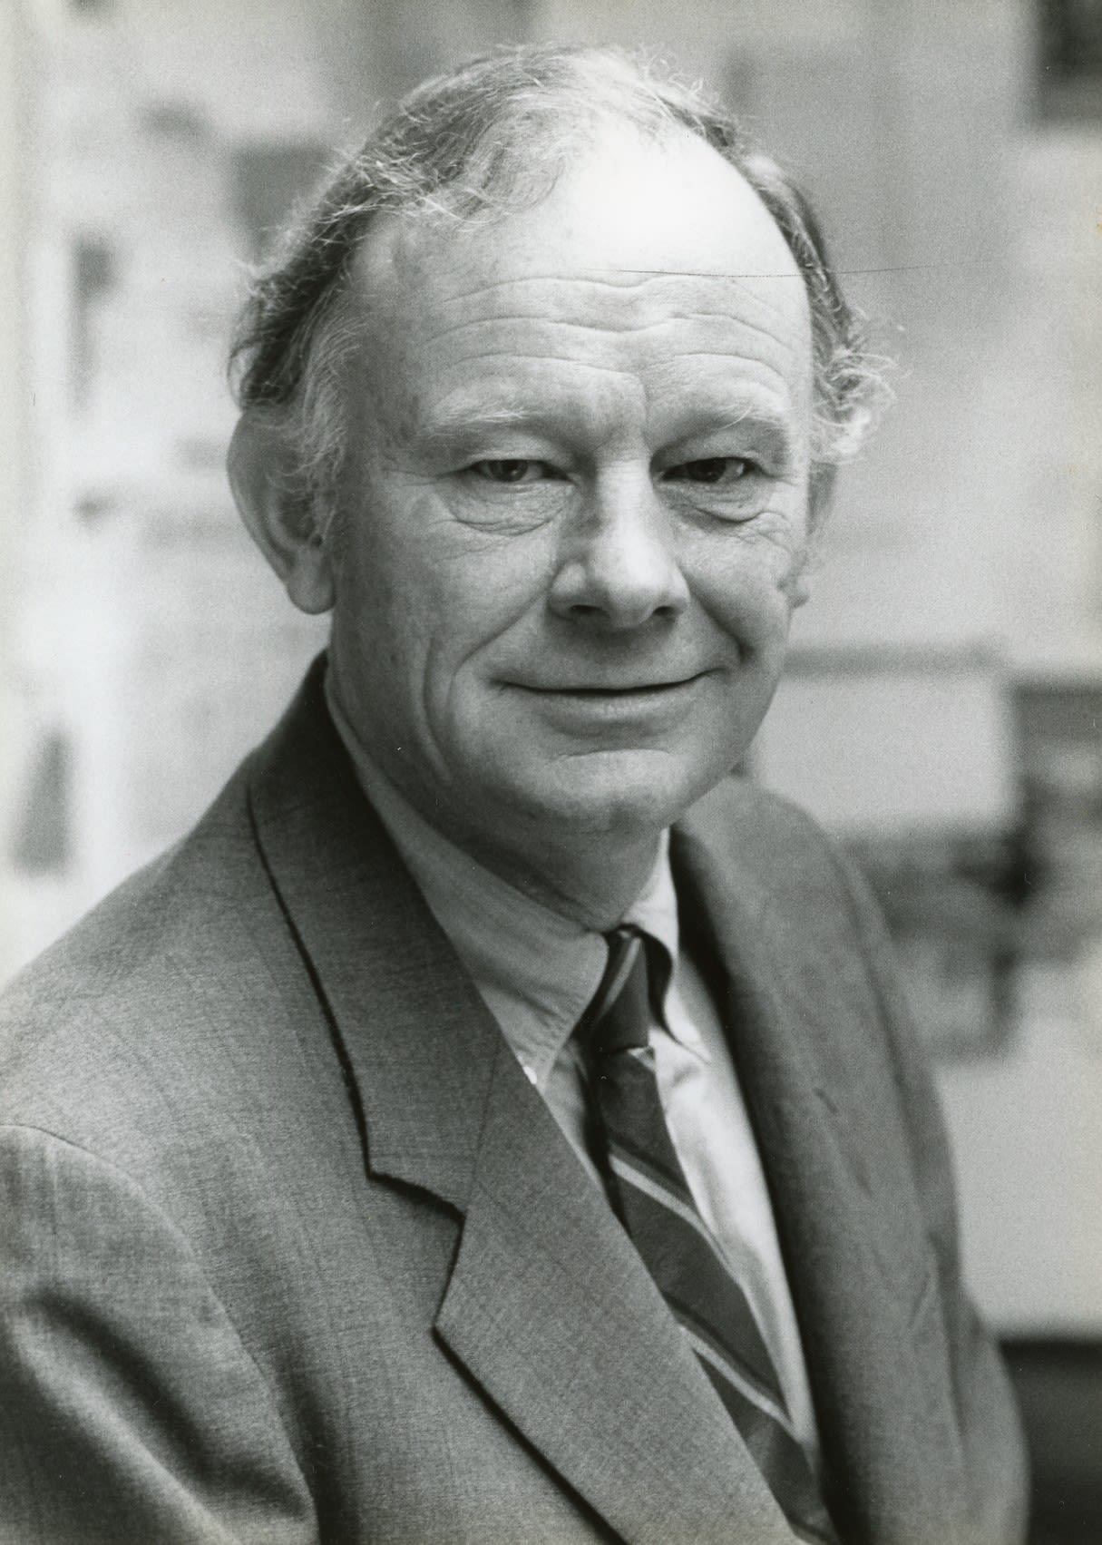
4. Learn the CARS (Create a research space) model for introductions
Editors are busy and reading quickly. Whether you have a clearly articulated introduction can make or break your article’s chances at publication.
The CARS model was theorized by linguist John Swales after studying published articles across a range of disciplines.
It provides a roadmap for writing academic introductions. It also works for conference proposals, abstracts, and other writing where your goal is to quickly and concisely get your point across.
John Swales, 1938-2025

Slide 9
The cars model in three moves
Establish a research territory
Establish a niche
Occupy the niche

Slide 10
Move 1: Establish a Research Territory
The research territory, or broad topic, is the context required to both understand and conduct the research being explored. Your goal is to explain the current state of scholarship in the field and answer the question, “Why is this general research area important?”
Language for Establishing a Research Territory
__________ has been extensively studied...
Interest in __________ has been growing...
Recent studies have focused on...
__________ has become a major issue...
Notes:
“Urbanization continues to accelerate worldwide, with over 68% of the global population projected to live in cities by 2050 (UN, 2018). As urban density increases, concerns about residents’ mental well-being have become pressing. Numerous studies highlight the health benefits of exposure to natural environments, including reduced stress and improved mood (Kaplan & Kaplan, 1989; Ulrich et al., 1991).”

Slide 11
Move 2: Establish a Niche
The niche is the reason or motivation for the research. You are preparing your audience to understand how your research relates to the background you have given, highlighting gaps/problems in current knowledge that justify or explain the need for further investigation.
Methods for Establishing a Niche
Make a counter-claim (something is wrong)
Indicate a gap (something is missing)
Raise a question or make an inference (something is unclear)
Continue a tradition (adding something)
Language for Establishing a Niche
Previous studies of __________ have not examined...
Such studies are unsatisfactory because...
One question that needs to be asked, however, is...
Research on __________ has mostly been restricted to _________ so...
Notes:
“Despite this growing evidence, the specific role of urban green spaces—parks, rooftop gardens, and community forests—remains under-examined. Existing research often treats nature exposure as a broad category, overlooking how different types and qualities of green spaces may differentially influence mental health outcomes (Smith & Lee, 2021). Moreover, most studies rely on cross-sectional data, limiting the ability to assess long-term effects.”

Slide 12
Move 3: Occupy the Niche
This step is an explanation of how you are responding to the need for further investigation. Explain how your research addresses the need you identified in the previous step and list your specific research objectives, questions, or methods.
Strategies for Occupying the Niche
Outline purpose(s) of your research
List research questions or hypotheses
Announce principal research findings
Indicate the structure of your research process
Language for Occupying the Niche
The purpose of this literature review is to...
This study aims to...
The evidence collected from this study demonstrates...
This review outlines/examines...
Notes:
“To address these gaps, the present study uses a three-year longitudinal design to examine how varying levels of access to urban green spaces influence symptoms of anxiety and depression among adults in five major U.S. cities. We combine satellite imagery with annual mental health surveys to test whether consistent exposure to high-quality green spaces predicts better psychological outcomes over time. Findings will inform urban planning and public health policies aimed at promoting mental well-being.”

Slide 13
5. Writing for academic journals
It’s okay to contact the editor with queries about your article and its suitability. In fact, they want you to!
If your article gets rejected or receives an unclear R&R request a meeting with the editor for additional/more specific feedback.
Journal style guides are (usually) terrible for a variety of reasons. Instead, before submitting, try modeling your article’s citation and language conventions after a recently published essay.

Slide 14
6. Use your campus resources
Our libraries and librarians rock. We in the CWE are huge fans.
The Center for Social Science Research
Office of Faculty Affairs
The Center for Writing Excellence

Slide 15

Our mission
Empowering writers every step of the way.
The CWE empowers all members of the AU community in their research and creative activities by providing tools for improving their written, oral, and multimodal composition skills. Because the writing process is social and recursive, all writers, regardless of discipline or ability, benefit from personalized support and opportunities for collaboration. We help writers develop and hone their process through explicit instruction and holistic pedagogical approaches that build on past knowledge to increase confidence and productivity.
Learning ■ Discovery ■ Student Success
We assist with writing, multimodal projects, and oral presentations for any subject or discipline at any stage in the writing process.
Notes:
wBefore I tell you a little bit about who we are and what we do specifically, I want to share with you our mission. Housed in the Pamplin College of Arts, Humanities, and Social Sciences, the Center for Writing Excellence empowers all members of the AU community in their research and creative activities by providing tools for improving their written, oral, and multimodal composition skills.

Slide 16
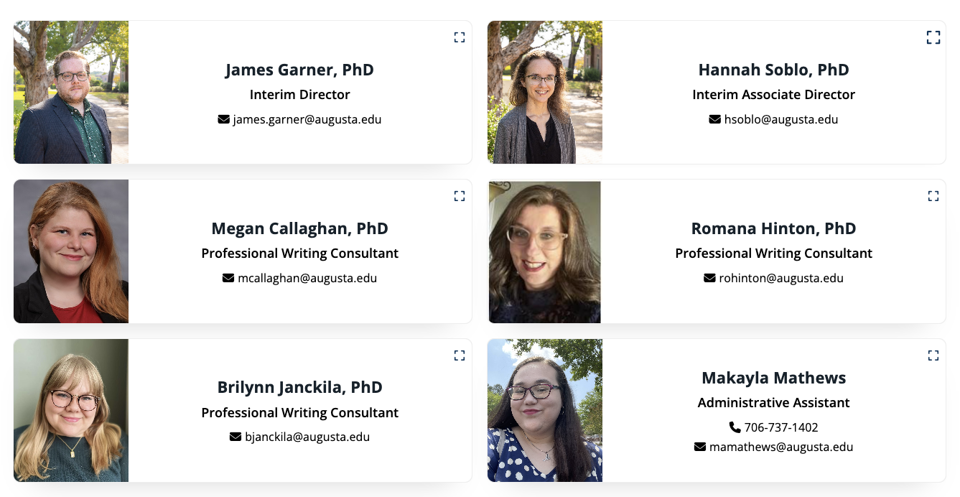
Who are we?

Slide 17
In ay 2024-25, the cwe held…
5150
479
Total appointments
Appointments with AU faculty
Projects included articles for publication, book proposals, conference abstracts and presentations, materials for tenure and promotion, grant applications, and research posters.

